Slide 1
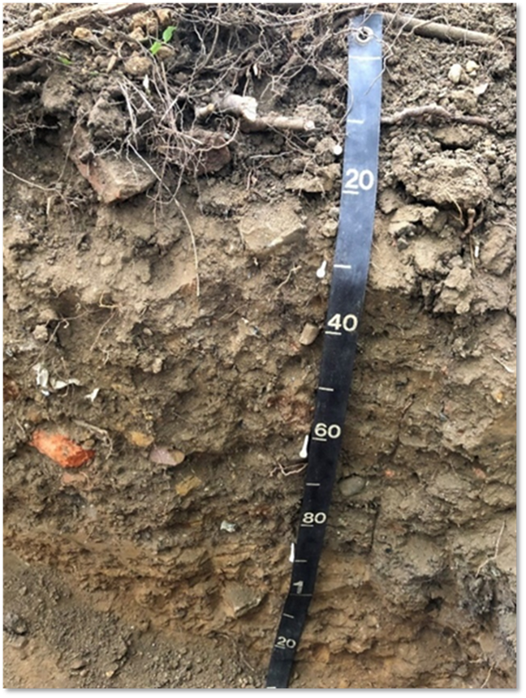
MODULE 3:
Soil Health
Resource Concerns
Notes:
In this module, we will review the NRCS soil health resource concerns. These concerns will be reviewed again later in the class as a part of the field activities.
There are a lot of questions and opportunities for discussion in this presentation and we would like this session to be as interactive as possible.

Slide 2
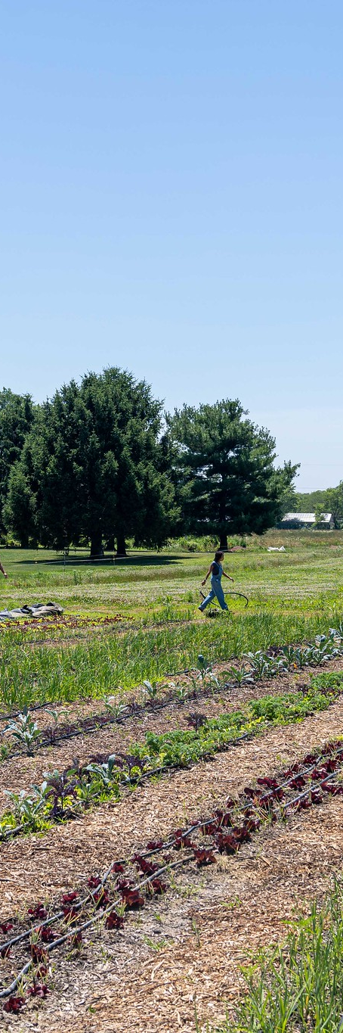
Objectives
Identify soil health resource concerns, and the natural resource conservation objectives, that are common in urban and small-scale agriculture systems.
Discuss soil management practices that lead to resource concerns in small scale agriculture.
List and recommend appropriate assessment methods for soil health resource concerns.
Distinguish soil health conditions that are unique to urban agriculture.
Notes:
These are the objectives for this module. Key focus is to think specifically about small-scale farming and how these resource concerns may present themselves in that context.
We will also look specifically at urban soils. We will discuss how soil properties and soil health resource concerns (and their assessment) can be different in urban areas/agriculture.

Slide 3
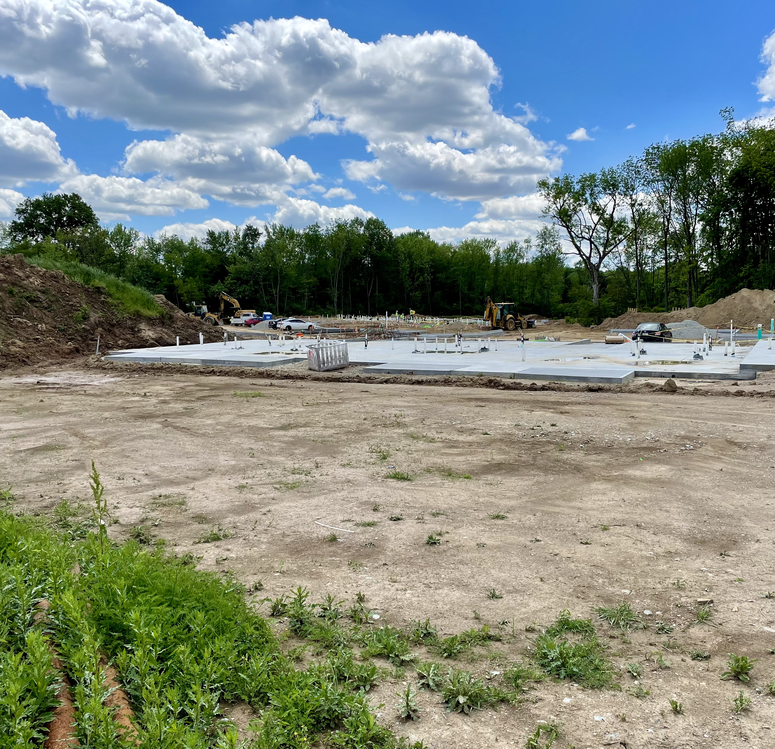
Soil Health Resource Concerns
Notes:
This section will look at the NRCS soil health resource concerns.
Photo: Josh Beniston, USDA NRCS. New residential neighborhood construction site. Indianapolis IN.

Slide 4
Question
NRCS has four soil health resource concerns - What are they?
Notes:
Ask the group the question and take responses.
The four Soil Health Resource Concerns are: Organic Matter Depletion, Aggregate Instability, Soil Organism Habitat Loss or Degradation, and Compaction

Slide 5
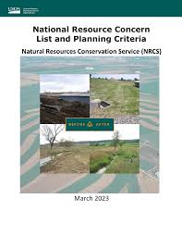
National RC List and Planning Critera
Policy, definitions and objectives.
Guidance on assessment methods.
Notes:
This publication is our national reference on resource concerns and provides information about how each resource concern can be assessed, as well as the objective for addressing the resource concern with conservation.
There is a lot of useful information in this document, and it is necessary reading for all staff.

Slide 6
Question
What soil health/soil-based resource concerns do you expect to encounter when you are working with small farms?
Or with urban agriculture?
Notes:
Ask these questions to the group. Start with the first question about small farms and discuss the responses to that specific context.
Then bring up the urban agriculture question and ask them to respond to that.

Slide 7
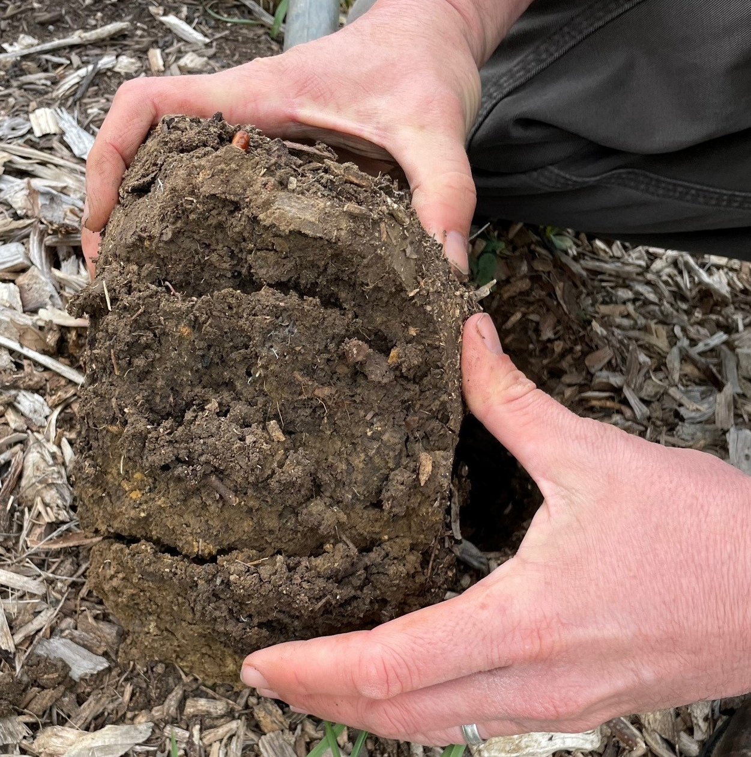
Soil Health Resource Concerns
What resource concern(s) can you identify in this photo?
Notes:
Jumping in to the soil health resource concerns themselves.
Ask the group what resource concern(s) they can identify in this photo. Also, what to they see visually that helps them ID this resource concern?
The photo is meant to demonstrate compaction. The key visual indicator in this photo is the very defined horizonal cracking that is occurring in this soil sample. Those strong horizontal lines are a primary indicator for soil compaction in the field.
Photo: Michael Higgins, USDA NRCS. Photo of a soil sample at an urban farm in Fort Worth TX. Sample shows soil compaction. This site had only been managed for urban agriculture for a couple of years. The soil had a texture with a significant amount of clay. Topsoil at the site had likely been heavily disturbed, and/or removed, in recent site history before conversion to urban ag.

Slide 8
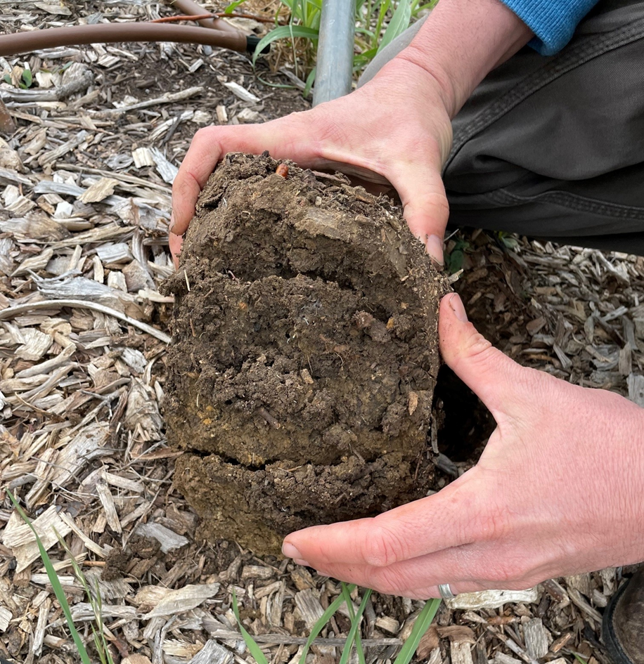
Compaction
Definition:
  Management-induced soil compaction at any level throughout the soil profile resulting in reduced plant productivity, biological activity, infiltration and aeration.
Objective:
  Reduce soil compaction.
How do we assess compaction (Crop land) ?
  National or State In-Field Soil Health Assessment
  Client Input/Planner Observation (Ponding, stunted root growth, etc.)
  Penetrometer
Notes:
This is a summary of the information for compaction from the national publication on resource concerns.
Can be good to ask participants how they generally assess compaction in the field and take a few responses ??

Slide 9
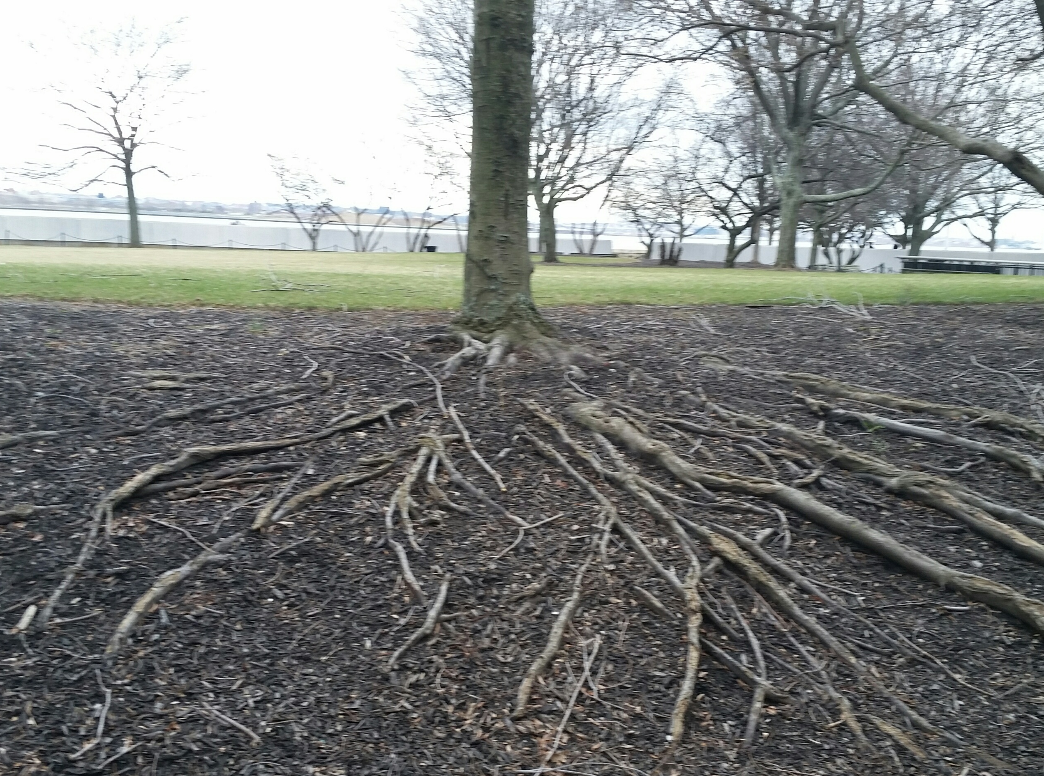
Compaction
Where have you found compaction in small-scale agriculture?
Where have you found compaction in urban areas?
What is one practice that you recommend for addressing compaction?
Notes:
Ask the group to answer these questions – and to focus their responses and discussion on these specific contexts.
Go through questions one by one and take a few responses from group for each.

Slide 10
Compaction
Where do we find compaction in small-scale agriculture?
  Intensive management during wet conditions.
  Systems with intensive tillage
Where do we find compaction in urban areas?
  Use of heavy machinery for construction and demolition of buildings
  Concentrated areas of foot traffic
Notes:
These are just a couple of examples for where we may find compaction in these situations.

Slide 11
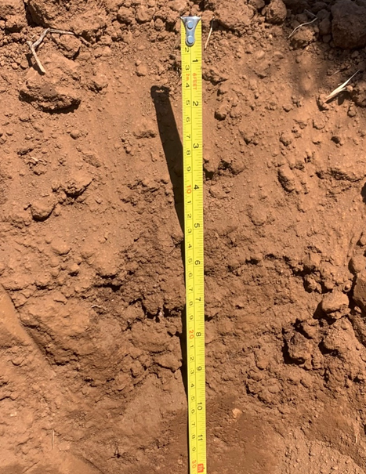
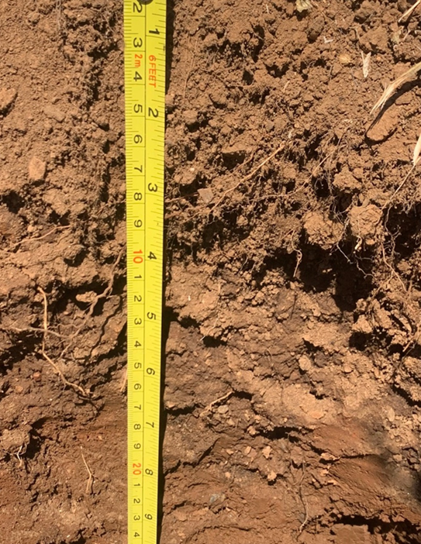
What’s Different?
Notes:
Ask participants to discuss resource concerns that they can see in these photographs. How are the two soils different.
These photos were taken at the same site, on the same morning, in the same soil series. Both soils are used to grow vegetables organically. The soil on the left is managed with intensive tillage by tractors at least once a year. The soil on the left has been managed with very minimal tillage, and a few years of no tillage at all, for more than five years. This soil has also received heavy applications of compost.
Response that we are aiming for here is that the soil on the left displays Organic Matter Depletion, particularly in comparison to the other photo.
Photos: Philip Smith, USDA NRCS.

Slide 12
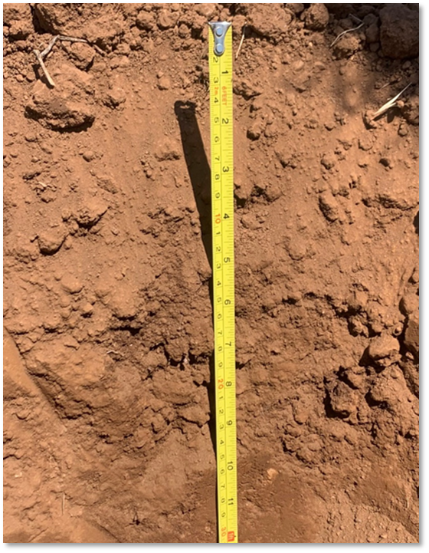
Organic Matter Depletion
Definition:
  Management induced depletion of any or all pools of soil organic matter resulting in limited soil function
Objective:
  Maintain, increase, or improve soil organic matter
How do we assess OM Depletion (Crop land) ?:
  National or State In-Field Soil Health Assessment
  Client Input/Planner Observation
  Soil test results
  Current NRCS wind or water erosion technology
Notes:
This is a summary of the information for organic matter depletion from the national publication on resource concerns.
Can be good to ask participants how they generally assess organic matter depletion in the field and take a few responses ?? What method is encouraged in their state?
Photo: Philip Smith, USDA NRCS.

Slide 13

Organic Matter Depletion
What kinds of management lead to organic matter depletion in small-scale agriculture?
Where do we find organic matter depletion in urban areas?
Notes:
Ask the group to answer these questions – and to focus their responses and discussion on these specific contexts.
Go through questions one by one and take a few responses from group for each.
Photo: Philip Smith, USDA NRCS.

Slide 14
Organic Matter Depletion
Where do we find organic matter depletion in small-scale agriculture?
  Intensive tillage and low return of organic materials.
  Baseline levels were low and not managed to increase.
Where do we find organic matter depletion in urban areas?
  Recent construction or demolition activities
  Topsoil layer has been removed
  Soil has been covered with inorganic materials or kept bare
Notes:
These are just a few examples from these systems. Fair to say that organic matter depletion can be common in both contexts.
Try to connect these examples to the responses that participants gave for the previous slide’s questions.

Slide 15
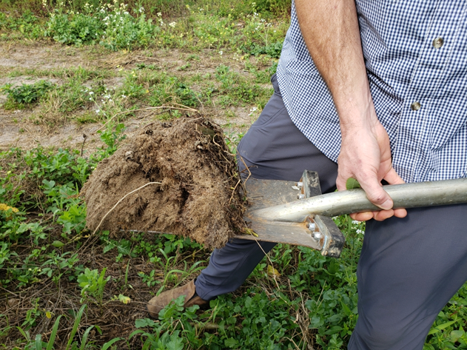
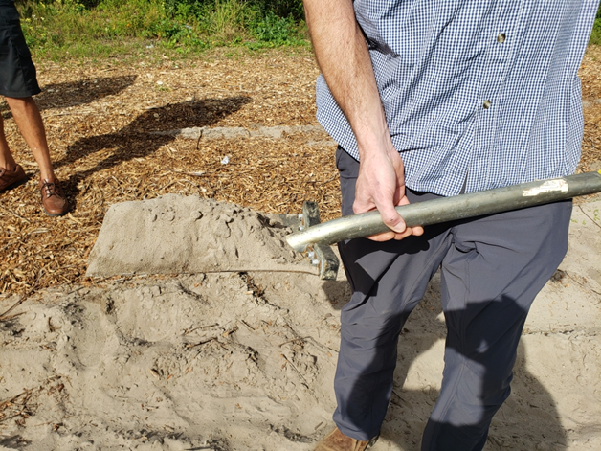
What’s Different?
Notes:
What resource concerns can be seen in the contrast of these two photos?
Move fairly quickly to the next slide for close up on soil samples and description of soils.
Photos: Nathan Lowder, USDA NRCS.

Slide 16
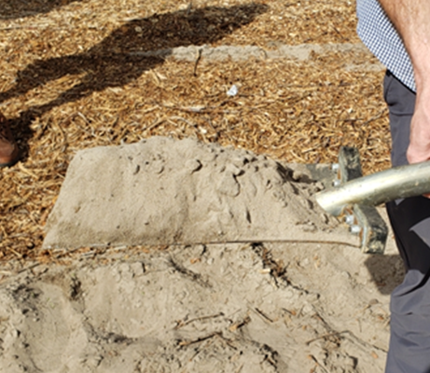
What’s Different?
Notes:
What resource concerns can be seen in the contrast of these two photos?
The response that we are looking for here is that the soil on the right demonstrates Soil Organism Habitat Loss or Degradation. That photo clearly also displays organic matter depletion, and likely aggregate instability.
These photos are an excellent example of the ability of good management to improve soil health in observable timeframes.
Photos: Nathan Lowder, USDA NRCS. Visual soil assessment of similar soil type on the same farm under different management systems. Soil on left has been managed for row crops with an intensive soil health management system, including cover cropping and no till, for many years. Soil on the right is an unmanaged soil from a field edge.

Slide 17
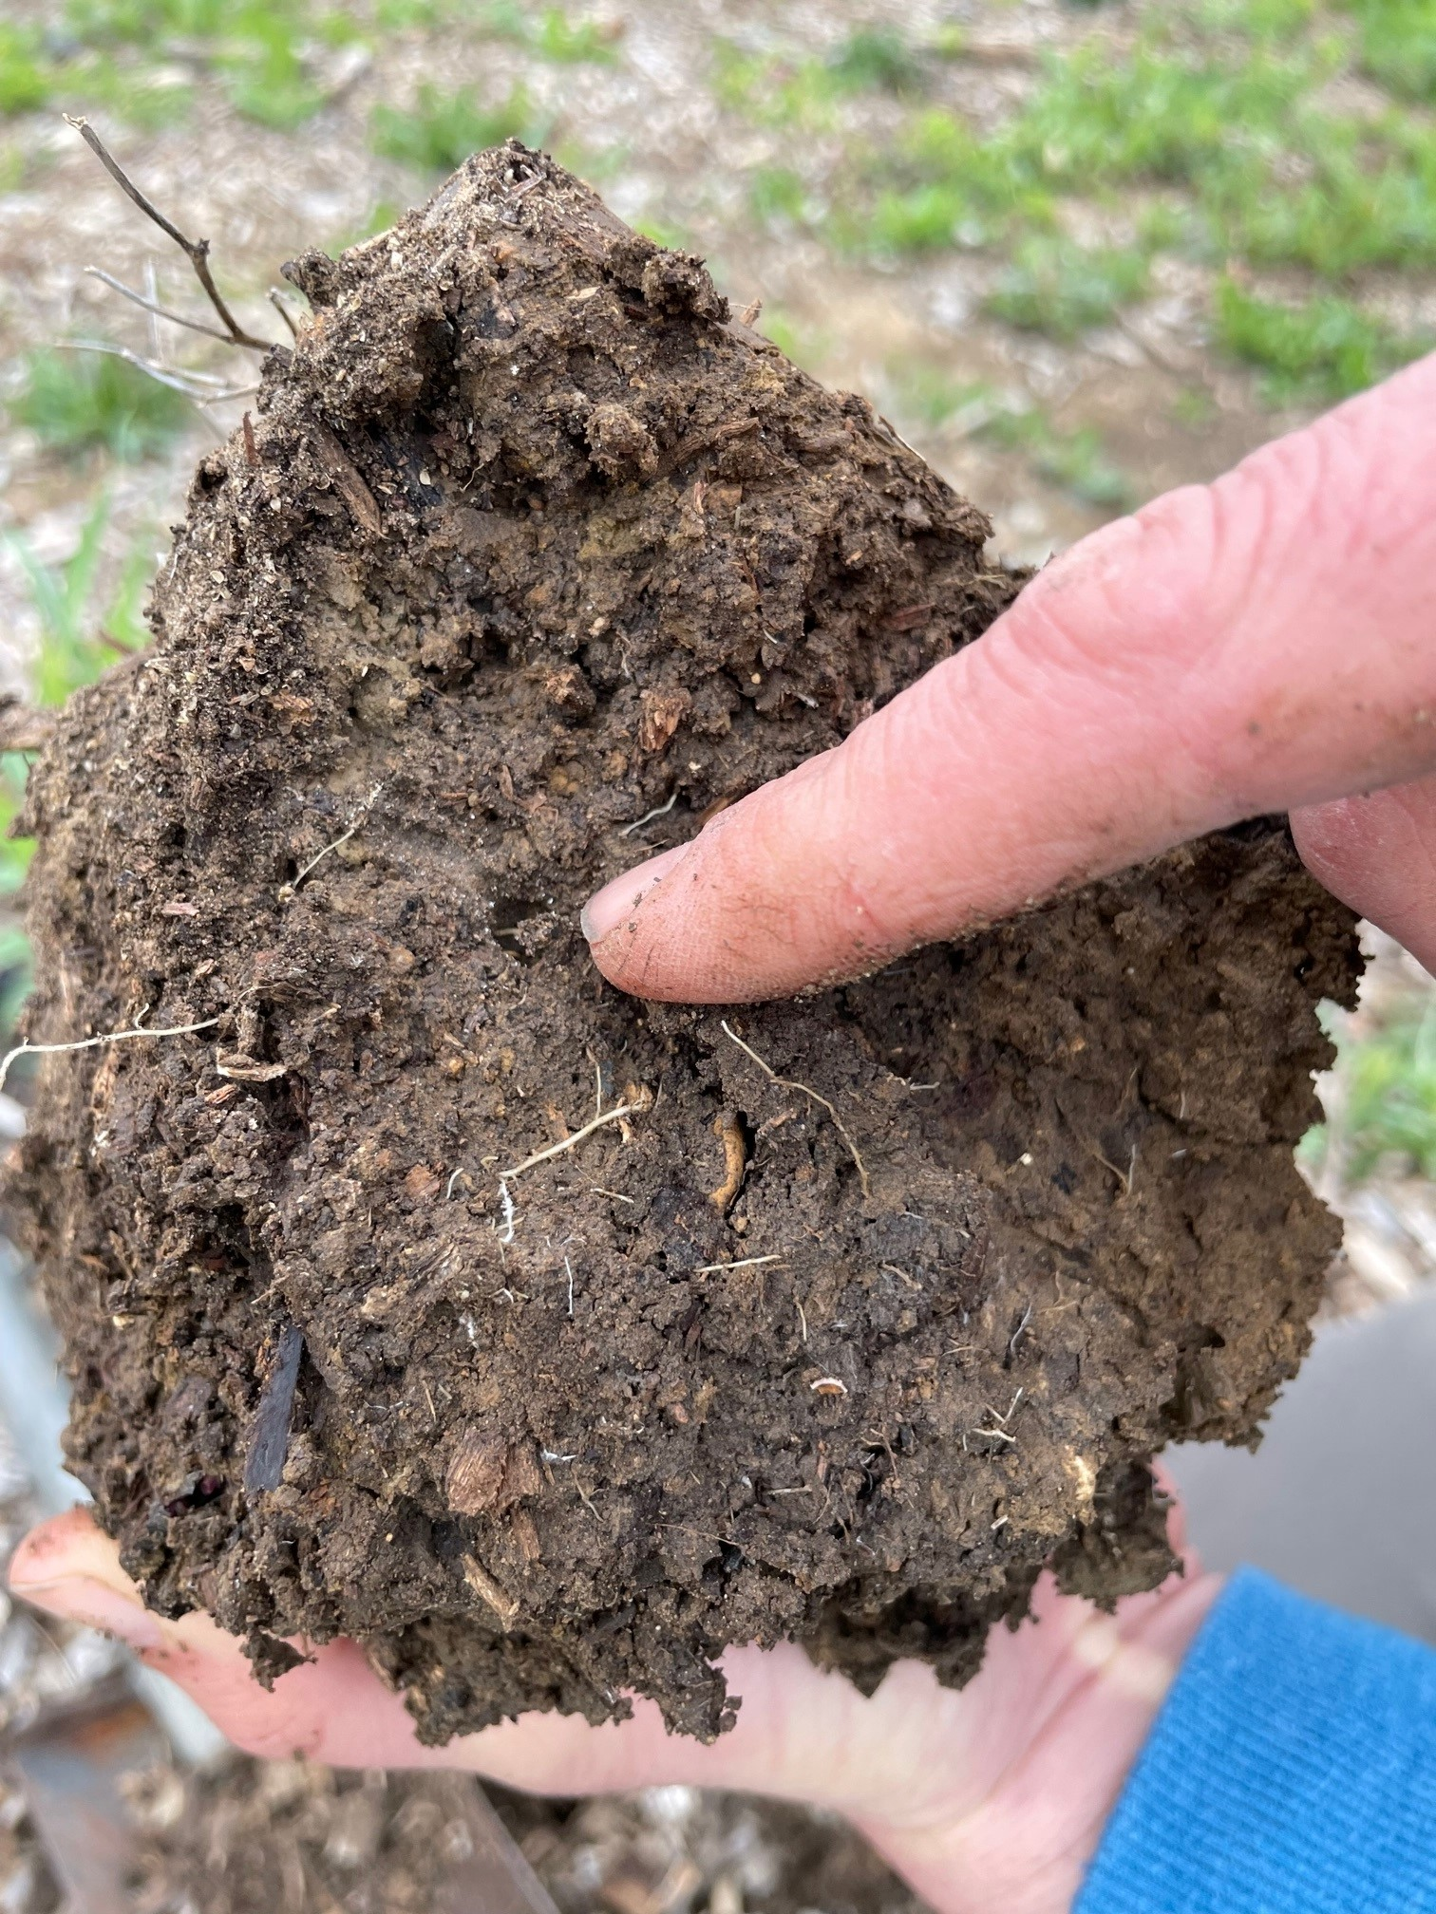
Soil Organism Habitat Loss or Degradation
Definition:
  Quantity, quality, diversity or connectivity of food, cover, space, shelter, and/or water is inadequate to meet requirements of beneficial soil organisms.
Objective:
  Improve habitat for beneficial soil organisms
How do we assess soil organism habitat (Crop land) ?:
  National or State In-Field Soil Health Assessment
  Client Input/Planner Observation
Notes:
This is a summary of the information from the national publication on resource concerns.
Can be good to ask participants how they generally assess organism habitat as a RC ? Do they use IFSHA ?
Photo: Michael Higgins, USDA NRCS. Plant roots and earthworms channels are improving the soil organism habitat at an urban farm. This site uses mulch, cover cropping and compost application in their soil management.

Slide 18
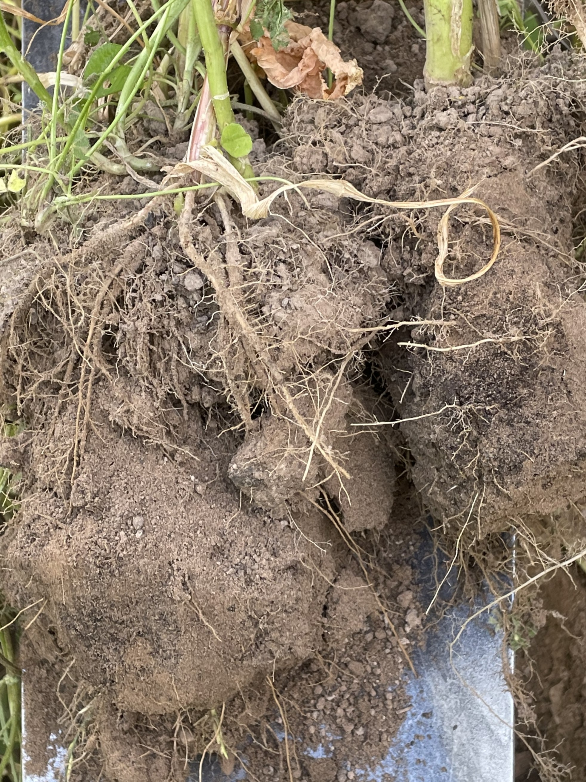
Soil Organism Habitat Loss or Degradation
What kinds of management lead to soil organism habitat loss in small-scale agriculture?
Where do we find soil organism habitat loss in urban areas?
Notes:
Ask the group to answer these questions – and to focus their responses and discussion on these specific contexts.
Go through questions one by one and take a few responses from group for each.
Photo: Josh Beniston, USDA NRCS. Photo shows a soil slice sample taken in a backyard garden with a multi-species cover crop mixture growing in it. The cover crop is improving the soil organism habitat by supporting aggregation and porosity. It is also adding a tremendous amount of food in the form of root biomass and exudates. Soil in the photo is a sandy loam with approx. 70% sand. It has only been used as a garden for a few years.
Soil organism habitat can be improved quickly with improved management.

Slide 19
Soil Organism Habitat Loss or Degradation
Where do we find soil organism habitat loss in small-scale agriculture?
  Low reside systems.
  Systems with fallow periods
Where do we find soil organism habitat loss in urban areas?
  Soil-less growing media
  Similar to organic matter depletion
Notes:
These are just a few examples from these systems.
Try to connect these examples to the responses that participants gave for the previous slide’s questions.

Slide 20
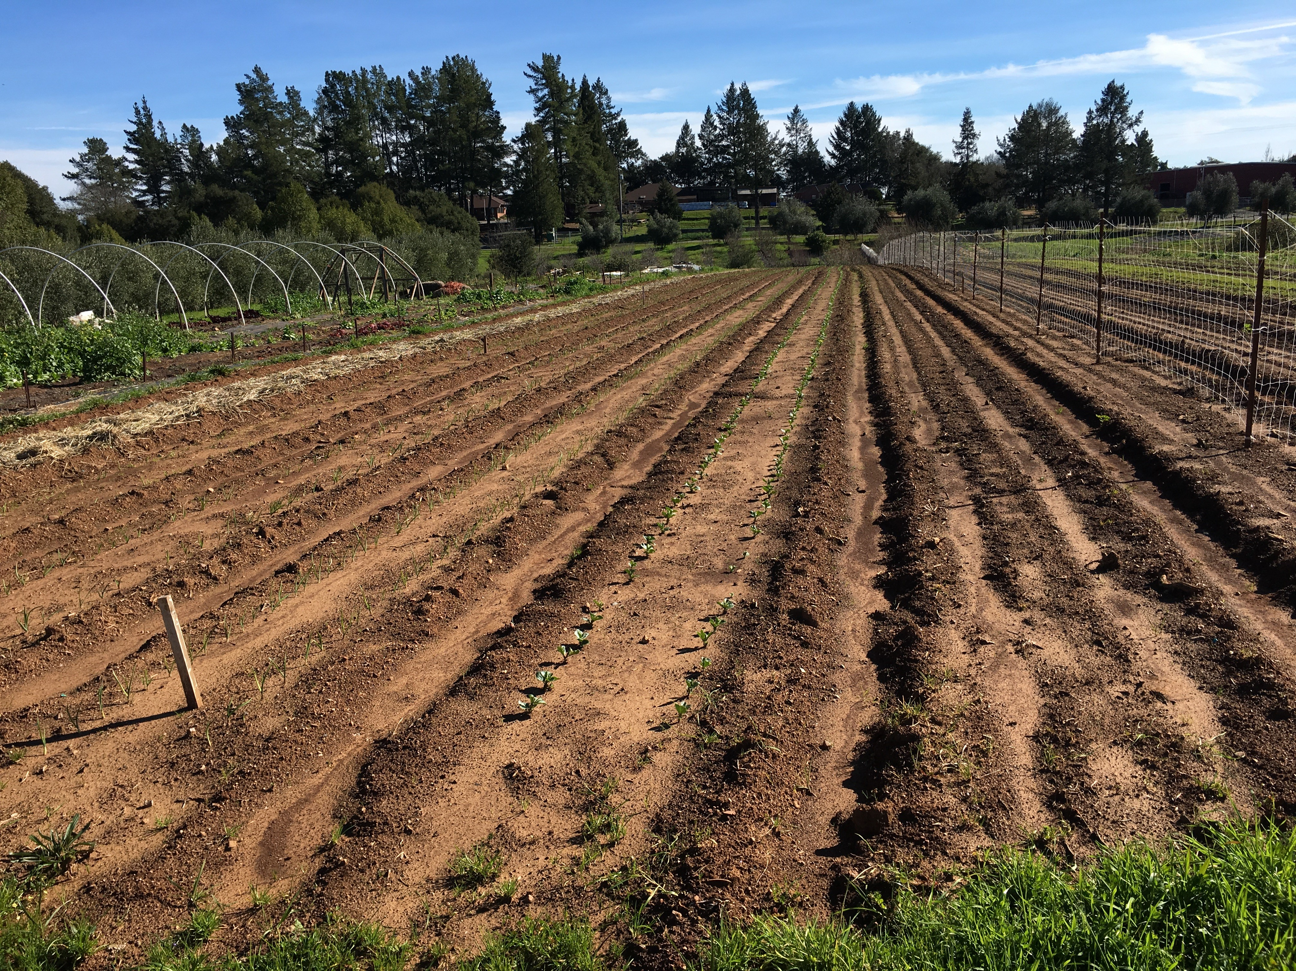
What’s Another SH Resource
Concern Here?
Notes:
What soil health resource concern can be observed in this photo? Ask the group for their ideas.
Again, it could be several. Slide is aiming to get the response of Aggregate Instability.
Photo: Josh Benistion, USDA NRCS. This was taken at an organic vegetable farm in northern California that utilizes intensive tillage after a significant, but not huge, rainfall. The photo shows the condition of a vegetable field where primary tillage, bed shaping, and transplanting of vegetable seedings had recently happened. The tillage disruption of the soil structure, as well as the lack of cover, made this soil more vulnerable to erosion during the rainfall. Visual indicators of significant erosion by water can be seen throughout this photo. These types of tillage practices are common on vegetable production farms and small farms.

Slide 21
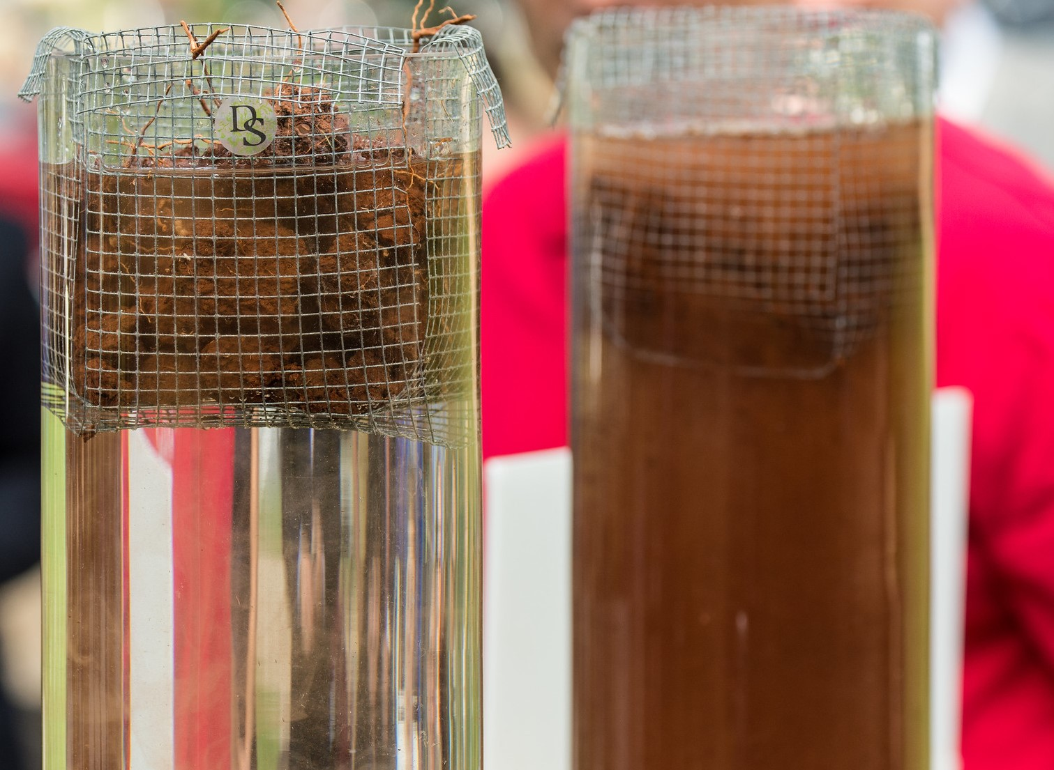
What’s Another Resource Concern Here?
Notes:
Same message as previous slide. Soil slaking demonstration in the second photo to demonstrate differences between a soil that has good aggregate stability and one that has an aggregate instability resource concern.

Slide 22
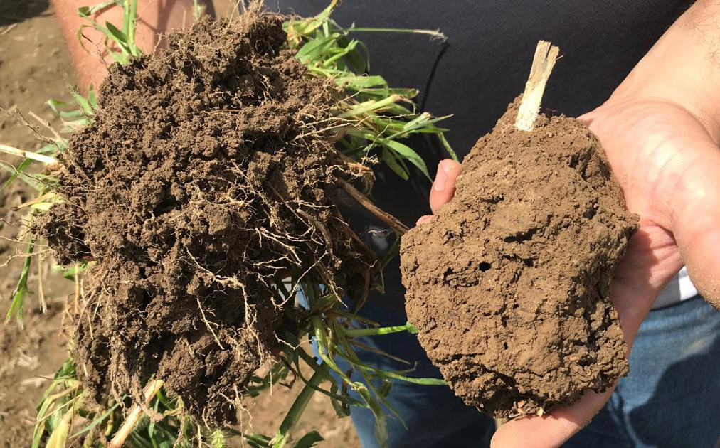
Aggregate Instability
Definition:
  Management-induced degradation of water stable soil aggregates resulting in…”impaired soil function”
Objective:
  Improve aggregate stability
Tools (Crop land):
  National or State In-Field Soil Health Assessment
  Client Input/Planner Observation
  NRCS-approved Water Soil Aggregate Lab Assessment Test
Notes:
This is a summary of the information from the national publication on resource concerns.
Can be good to ask participants how they generally assess aggregate instability?

Slide 23
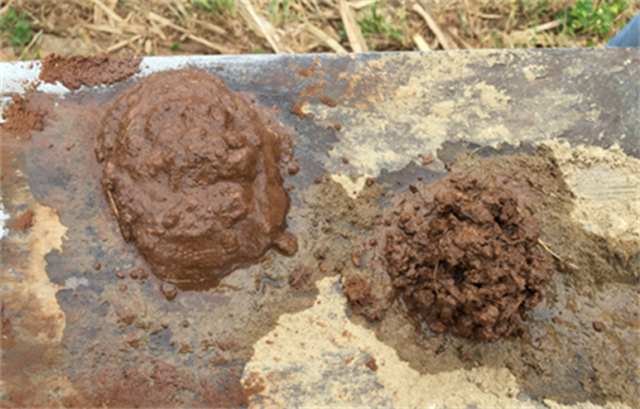
Aggregate Instability
Where do we find aggregate instability in small-scale agriculture?
  Intensive tillage
  Lack of soil cover
Where do we find aggregate instability in urban areas?
  Conditions mentioned for previous concerns
Notes:
This slide has questions and responses on one slide. Click through slide slowly and ask questions, and take responses from participants.
These are just a few examples from these systems.

Slide 24
Discussion
What other resource concerns are commonly found in urban areas ?
Notes:
Switching our focus over to urban areas and agriculture. Broad discussion question. Ask the group the question above and take several responses?
Responses may vary

Slide 25
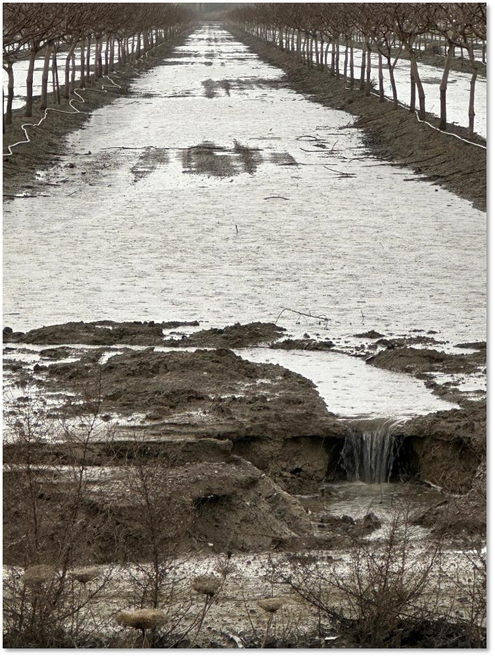
Other Resource Concerns
Ponding
Seasonal high water
Erosion (“sheet and rill”)
Nutrient transport
Plant productivity and health
Plant pest pressure
Irrigation/salts
among others….
Notes:
This is a list of several resource concerns that may affect site management, and even suitability, for urban agriculture.
There are others also.
Photo: Z. Kabir, USDA NRCS. Runoff in an orchard in the Central Valley of California following a heavy rainfall. This site did not have a cover crop or soil cover.

Slide 26
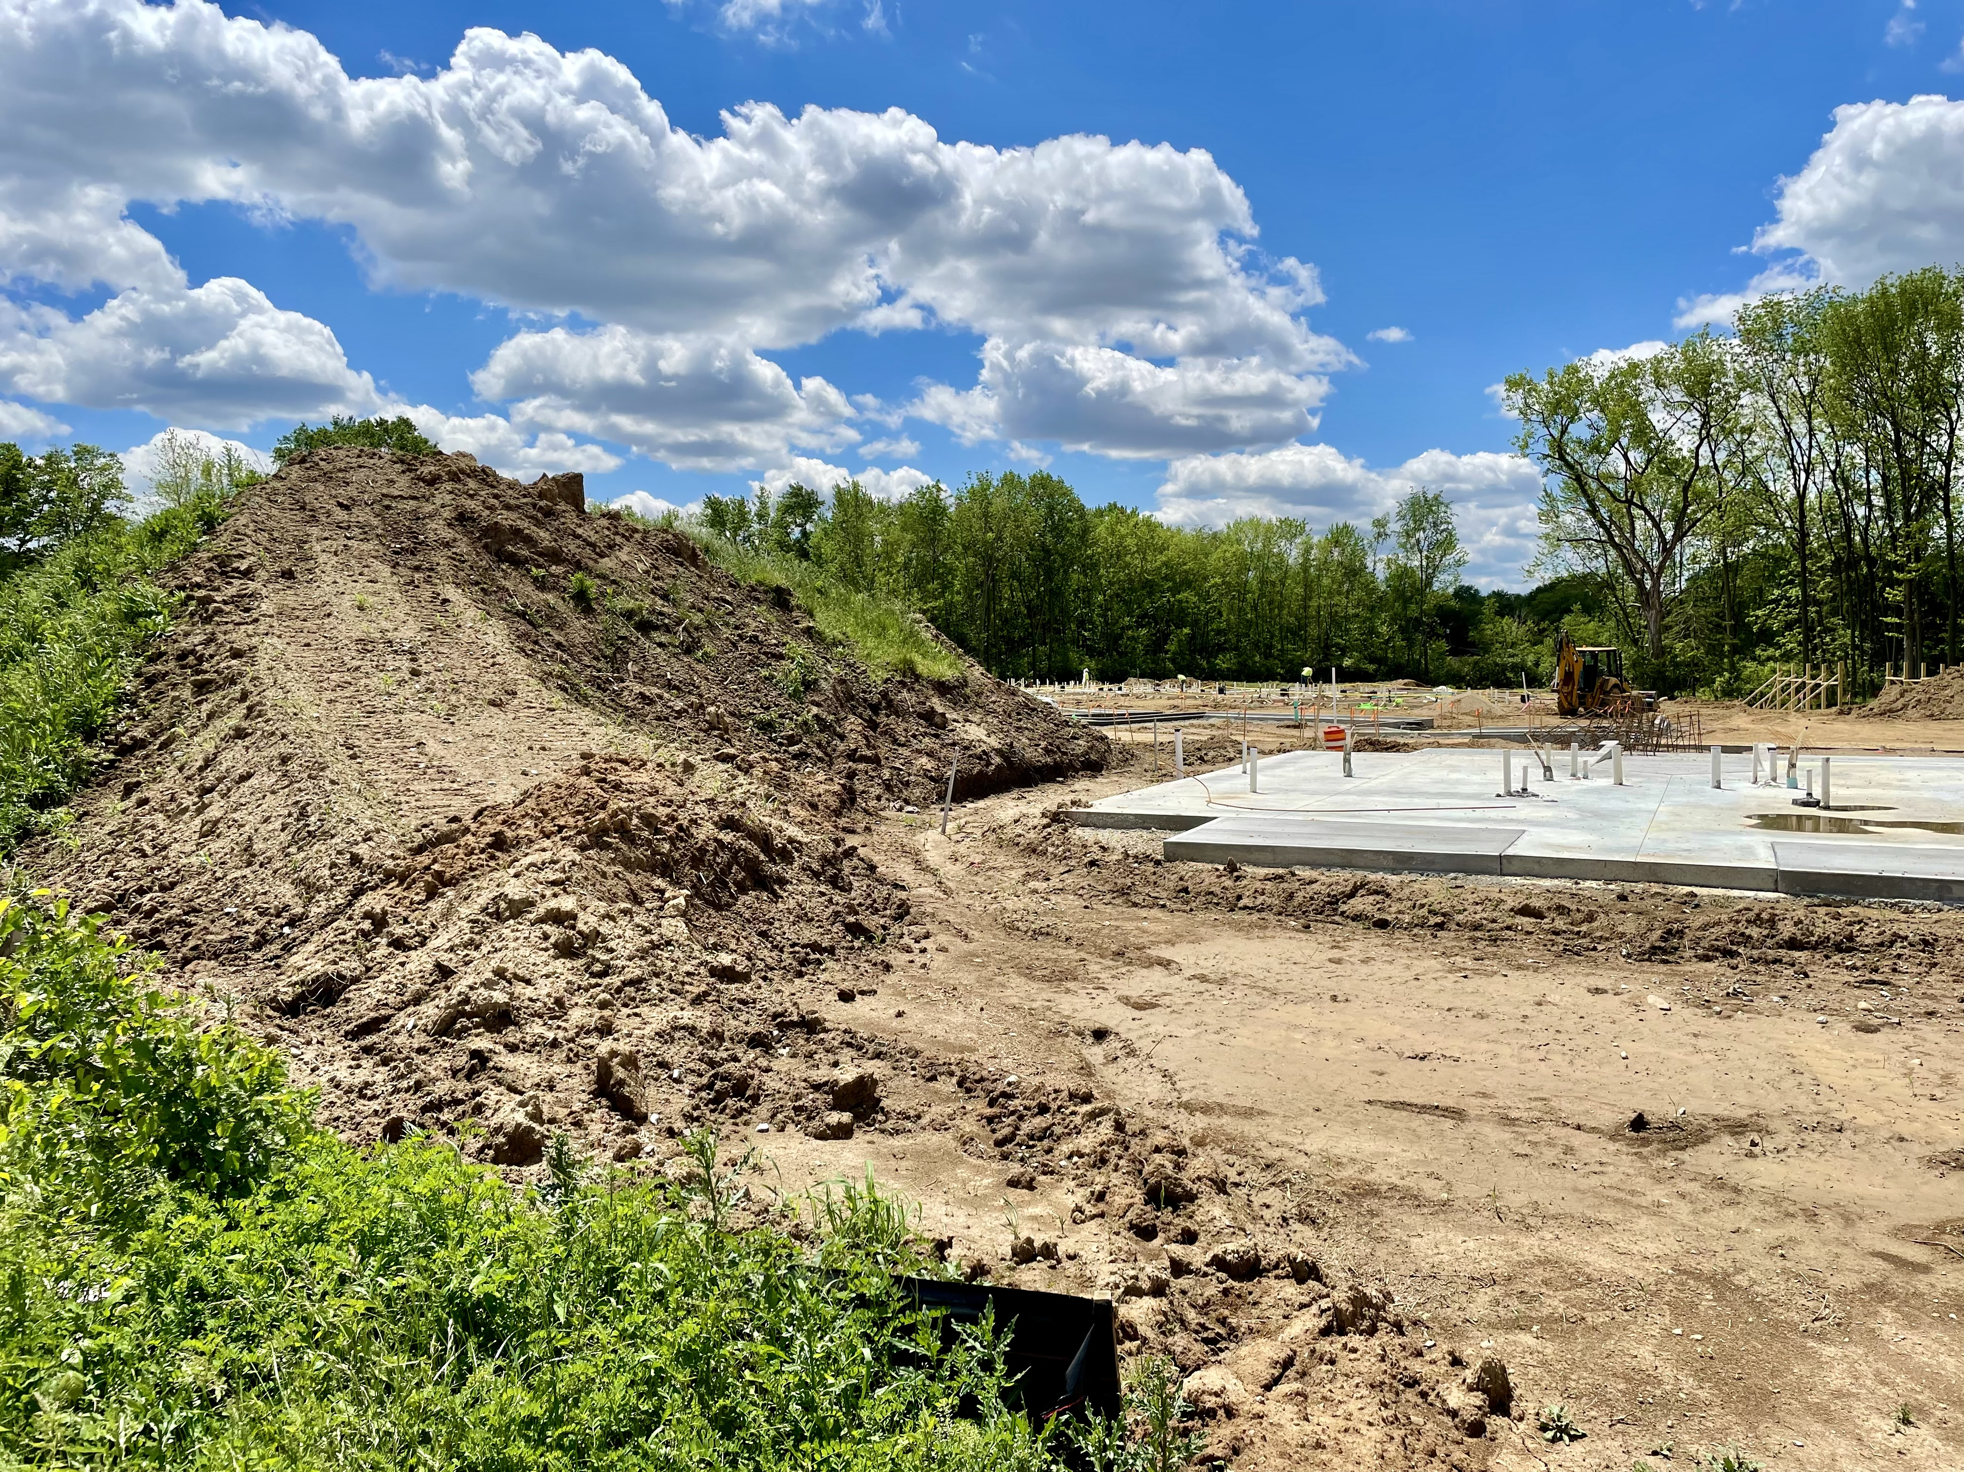
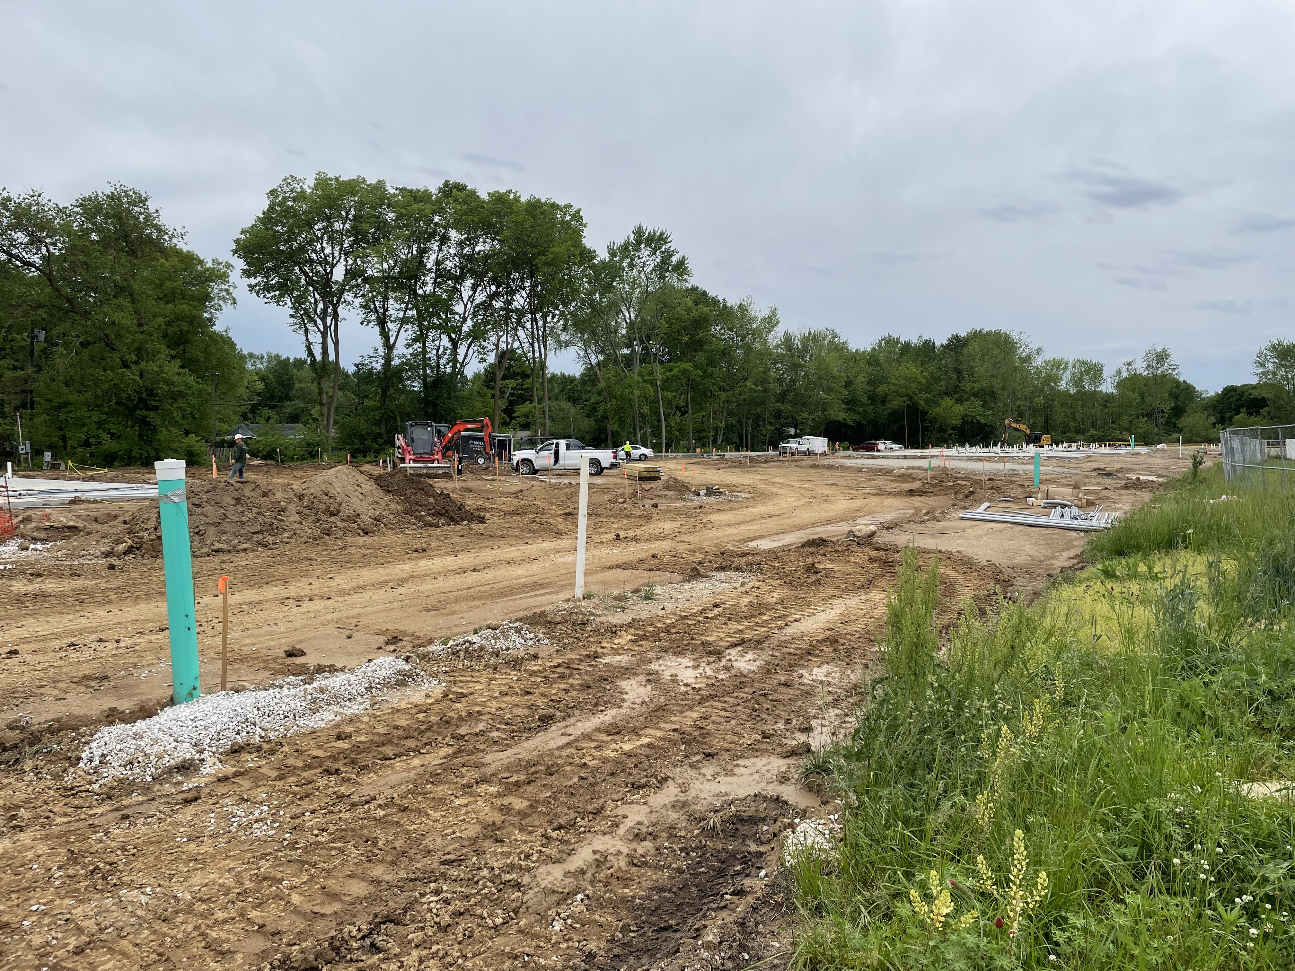
Urban Soil Health Concerns
Notes:
We will transition to looking specifically at urban soils. We will discuss factors and properties that may be unique in urban soils and will also look at how soil health resource concerns may be unique in urban areas.
Photos: Josh Beniston, USDA NRCS. Severe soil disturbance at a residential construction site in Indianapolis IN. This type of major disturbance will likely leave lasting impacts on the soil properties and soil health at the site.

Slide 27
Question
Is there a typical urban soil ?
Notes:
Ask the group this question and take a few responses?

Slide 28
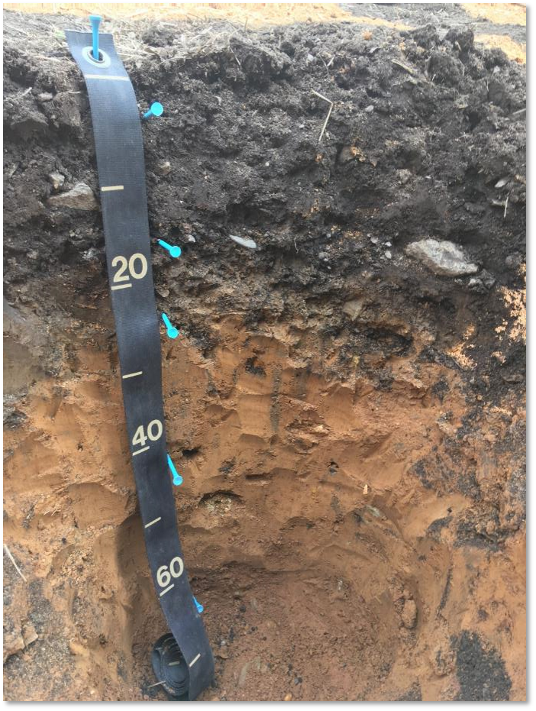
Characteristics of Urban Soils
Continuum of soil conditions from native soil types through soils significantly altered by humans.
Site management history is major factor for soil properties and health.
Many urban soils have robust health and conditions for plant growth
Present excellent opportunities for conservation
Photo: Randy RIddle, NRCS
Notes:
The response to the previous slide’s question is No, there is not really a typical urban soils.
The bullet points contain the primary points of this slide. (1) A diversity of soil types and conditions are found in urban areas and (2) the management history of the site is considered an overarching factor that determines soil conditions. A key aspect of site history isurban the degree of and time since major disturbance at the site, where relatively undisturbed sites can have robust soil health, while more recently or heavily disturbed sites may present degraded soil conditions. Because of the impact of site history, urban soils can vary quite a lot at the site level in many areas.
Photo: Randy Riddle, USDA NRCS. An urban soil profile photographed and described as part of the Los Angeles CA soil survey.

Slide 29
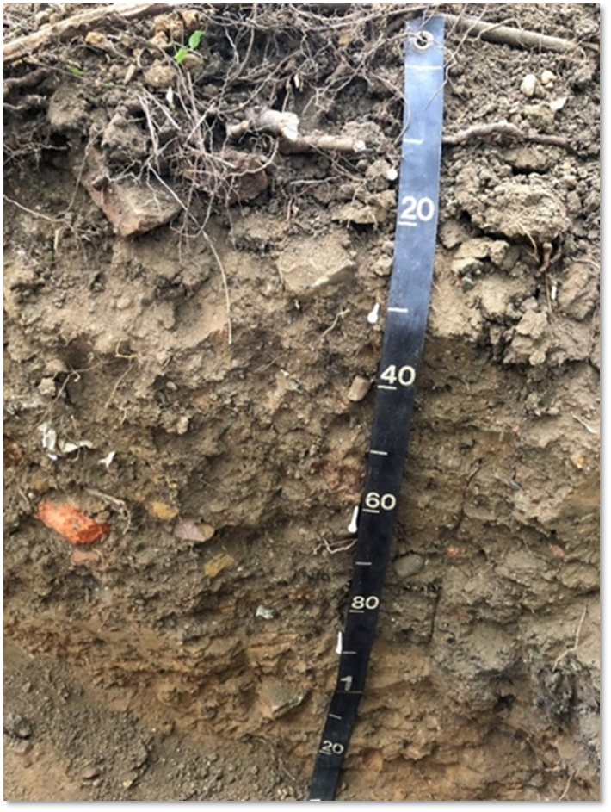
Human Altered and
Human Transported Soils
HAHT
Artesols – proposed order
Intentionally modified by humans
Often to support building and transportation infrastructure around cities.
Contain artifacts in profile – ex. building materials or brick.
Photo: Ben Marshall, NRCS
Notes:
The modern term that is used to described more “heavily disturbed” urban soils is “Human altered and Human transported” which is abbreviated as HAHT. These soils were intentionally and significantly modified by humans, generally with the goal of supporting buildings and transportation infrastructure in cities.
There is a currently an active proposal to add a 13th soil order to the U.S. Soil Taxonomy – Artesols. Artesols are HAHT soils that are generally found in urban areas. The name refers to the criteria that these soils contain “artifacts “ in their profiles. Artifacts in this context are materials from past human activity at the site – often building materials such as bricks and cement, or industrial byproducts like slag. Human alteration is considered a primary soil forming factor for the Artesols.
Photo: Ben Marshall, USDA NRCS. An urban soil profile that contains a significant concentration of artifact materials, including the bricks that are very visible in the photograph.

Slide 30
Properties of urban soils
Table 1: Properties of Urban Soils
Physical properties
Parent materials | human-transported materials
Coarse fragments | High concentrations of coarse fragments
Horizons | May be missing particular horizons, such as topsoil.
Spatial Variability | High levels of both horizontal and vertical variability
Chemical properties
Heavy metals & Organic compounds | Increased potential for soil contamination by heavy metals and organic compounds
Nutrient content | Variable nutrient content.
pH | Variable pH. Can have alkaline pH from incorporation of cement-based building materials.
Biological properties
Organic matter and carbon | Variable. Can be extremely high as well as very low, based on site management history.
Notes:
The table in this slide is a compilation of soil properties that are commonly distinct in urban soils, as compared with soils in rural or agricultural areas. This information was compiled from review of recent research publications on urban soils, and the table is taken directly from the NRCS Technical Note 470.02 “Basics of urban soil health.”
With regard to soil profiles, urban soils display as much or more variability in soil properties as rural soils. The variability in soil properties can be both horizontal variability in space or vertical variability in profiles. Urban profiles are also often missing particular soil horizons or their horizons may occur in an irregular fashion, due to a history of disturbance/human alteration at these sites.
For the more specific soil properties mentioned, the distinction of urban soils is often one related to “concentration” in that urban soils may have much higher concentrations of coarse fragments, heavy metals, and even organic carbon in their profiled. A key these across all of these properties is variability and observations of urban sites at both ends of the spectrum for soil properties such as carbon, which may be quite high or very low.

Slide 31
Are we familiar with this term in an NRCS context ?
What kinds of sites present “unsuitable” growing conditions?
“Unsuitable for production”
Notes:
Ask participants to respond to these two questions. Take a few responses for each.

Slide 32
“Unsuitable for production”
Not NRCS Resource Concern
Condition where NRCS ICPS 812 Raised Beds is applied
“This practice applies to land in habited areas where the desired new use of a site is for agricultural crop production and existing soil conditions are significantly impaired by
  poor fill material (e.g., heavy clay),
  non-biodegradable materials from previous use (e.g., bricks, concrete, asphalt, etc.),
  and/or the potential for heavy metals and other contaminants that can pose a health risk for edible crops.”
Notes:
The terminology of “Unsuitable for production” is taken from the interim conservation practices standard for Raised Beds (ICPS 812), It describes sites where the ability to grow crops is significantly impaired by the conditions listed above. It is not an official NRCS resource concern, but is a requirement for utilizing ICPS 812.
The conditions described here are common in many urban soils and at sites that may be available for urban agriculture projects.

Slide 33
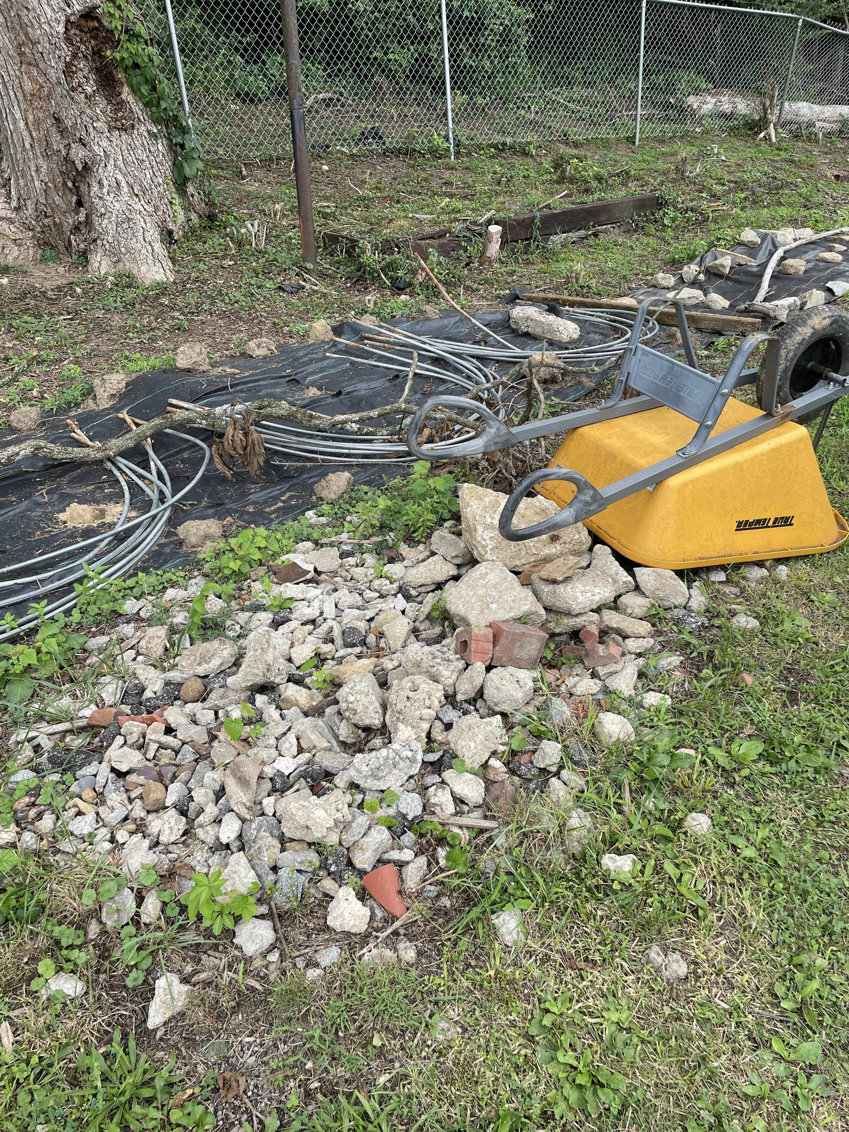
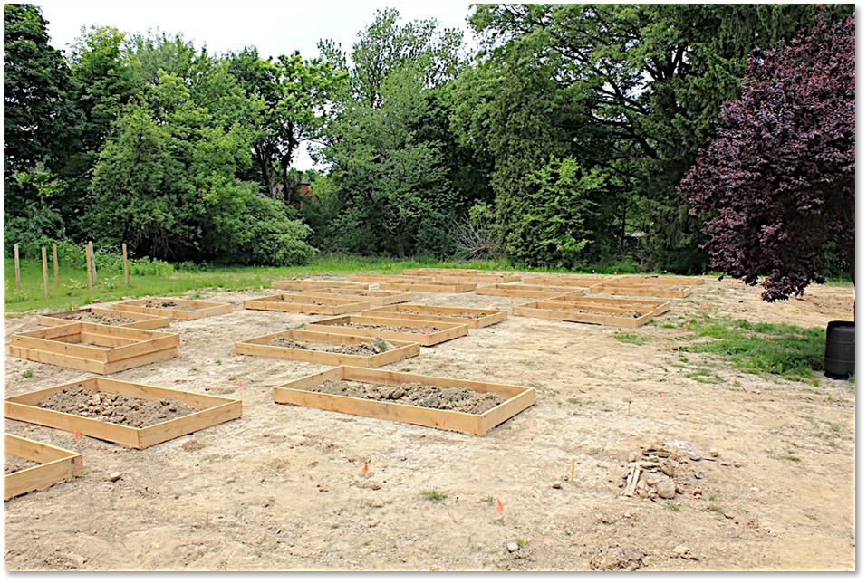
“Unsuitable for production”
Notes:
These photographs show two urban agriculture sites that are examples of the “unsuitable for production criteria”.
The photograph on the left shows the coarse fragments, mostly concrete and bricks, that a producer has removed from an urban garden and orchard site.
The photograph on the left shows the initial establishment of an urban research and demonstration garden on a site where two vacant houses had been demolished by the city and the goal was to re-purpose the site as a garden or green space. During the demolition process, the topsoil was removed from the site and the remaining subsoil material was heavily compacted. Wooden frames for new raised beds can be seen in the photo.
Photos: Josh Beniston, USDA NRCS (L) Cincinnati OH and (R) Youngstown OH.

Slide 34
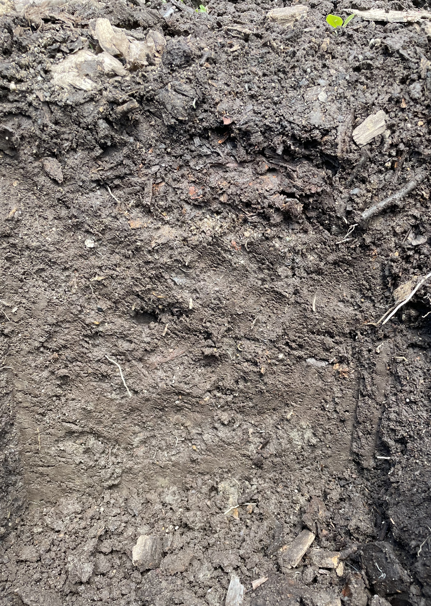
Highly amended soil
Notes:
The factors that we have just discussed of high levels of human alteration and high levels of variability in soil properties can lead to challenges with the assessment of soil health at urban agriculture sites. The vast majority of soil health assessments and tests have been developed in rural agricultural soils, which look and behave differently than many urban soils.
A common soil condition found at many urban agriculture sites is that or sites that have been highly amended in an effort to rapidly improve the condition of the soil at the site. This is generally done with heavy applications of compost and/or mulch – that would not be practical on larger scale farms. This practice can result in a soil like the one in the photograph that has a thin surface layer of organic rich material above a subsurface layer that is less developed structurally.
This photograph was taken at a very productive market garden/small farm in a residential urban area that produces vegetables for local markets.
Photo: Josh Beniston, USDA NRCS. Urban market garden soil. Indianapolis, IN.

Slide 35
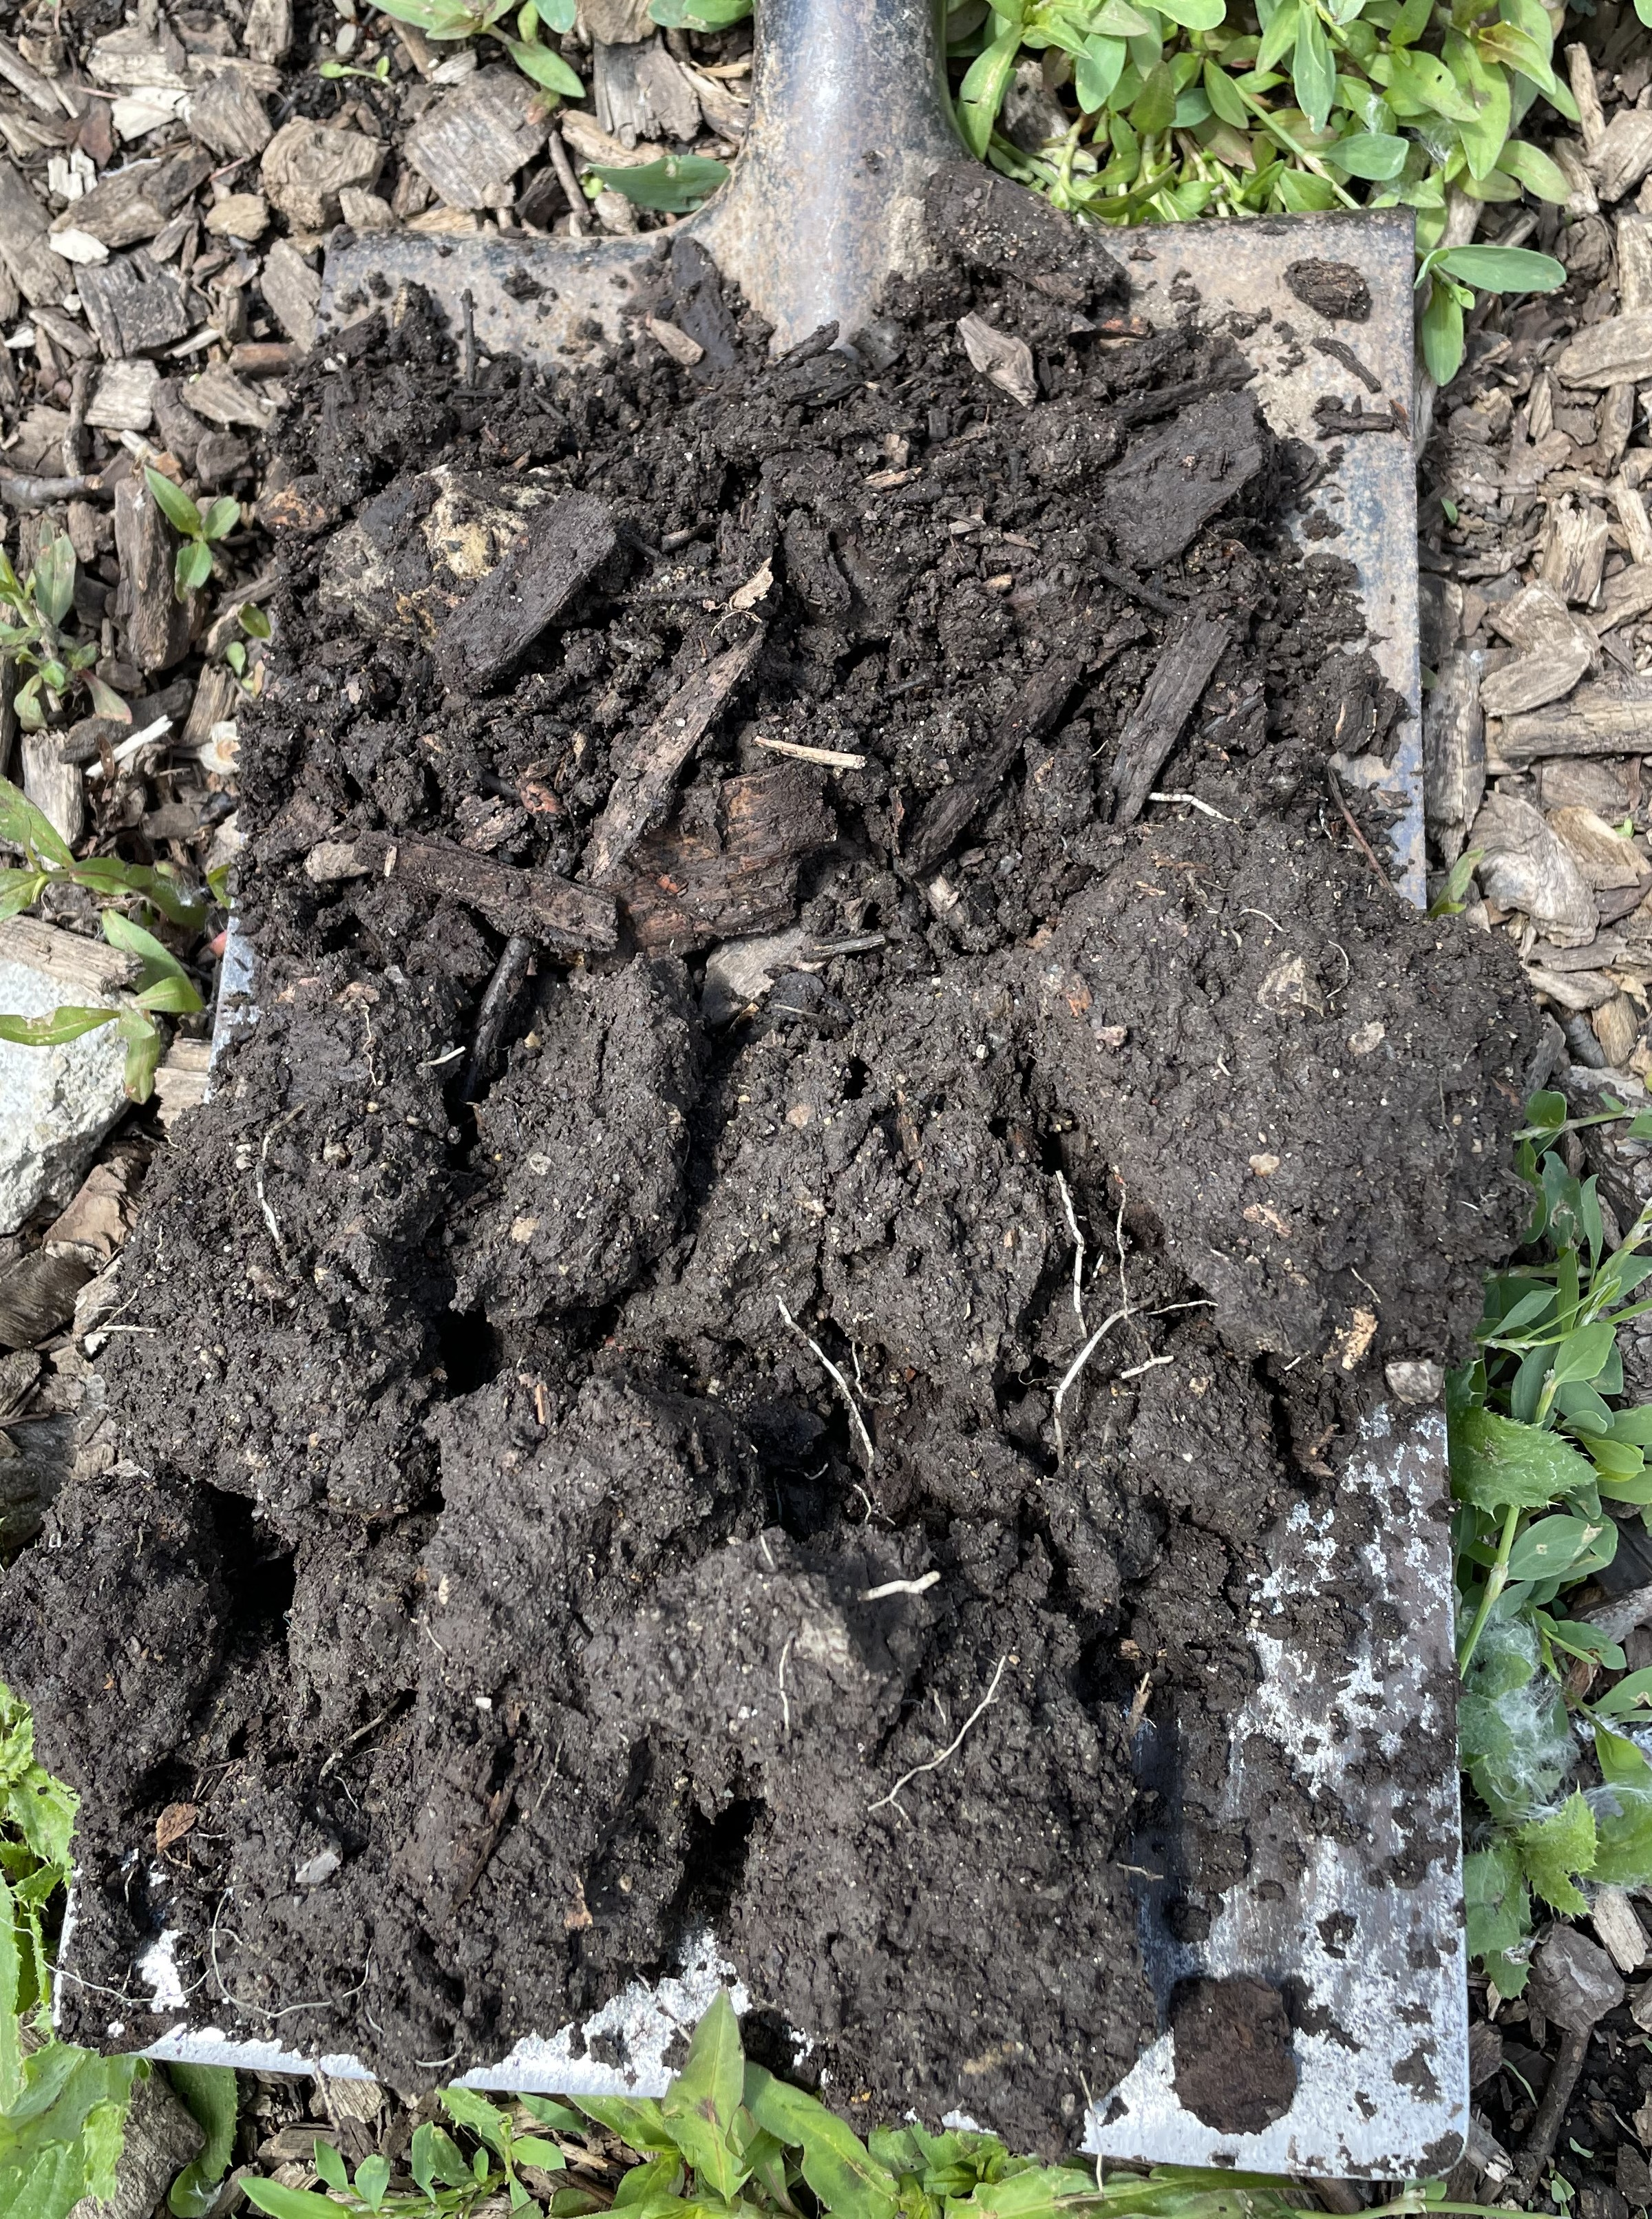
Highly amended soil
Notes:
A “slice” sample on a spade from the soil in the preceding slide. The sample shows the structural peds of the surface and subsurface layers.
Photo: Josh Beniston, USDA NRCS. Indianapolis, IN

Slide 36
What do we think about soil health?
What looks good? Resource concerns?
Notes:
Ask participants to discuss these questions and take several responses.
After examining these photographs and understanding a little bit about the management history of the site, do you think that the soil in these photos displays “good soil health”? Are there any resource concerns that jump out at you? (not really anything obvious)
Can you make any recommendations about additional management at the site based on what you see in the photos?
Hopefully this will generate some interesting conversation.

Slide 37
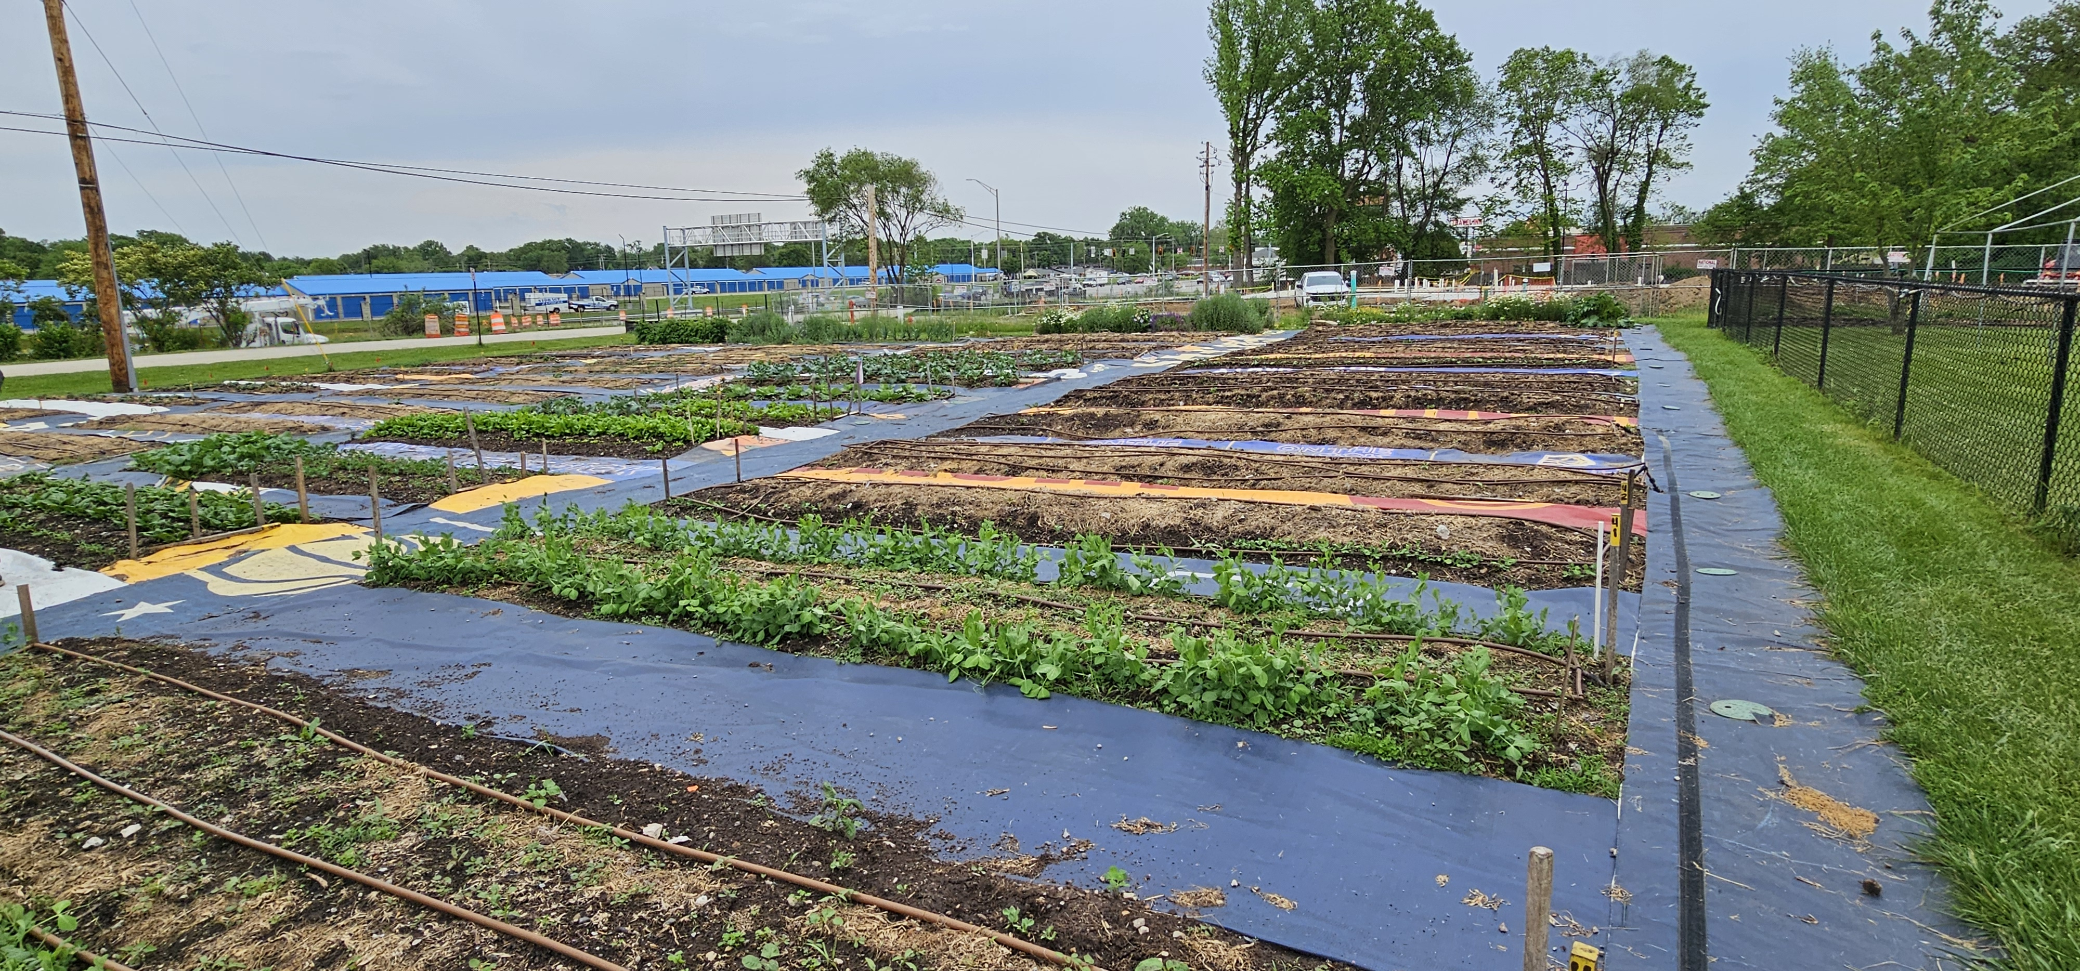
Community Garden – High Compost Use
Notes:
This slide follows on the preceding three. This is a community garden run by volunteers at a church. They used repeated, annual, heavy applications of compost for several years to greatly improve the soil condition and productivity of this garden.
They invited our NRCS group to tour the site. They also shared soil test results with us, described their management practices, and asked for our feedback. Our group also conducted cropland in-field soil health assessments in the garden soil.
Photo: USDA NRCS, Indianapolis IN

Slide 38
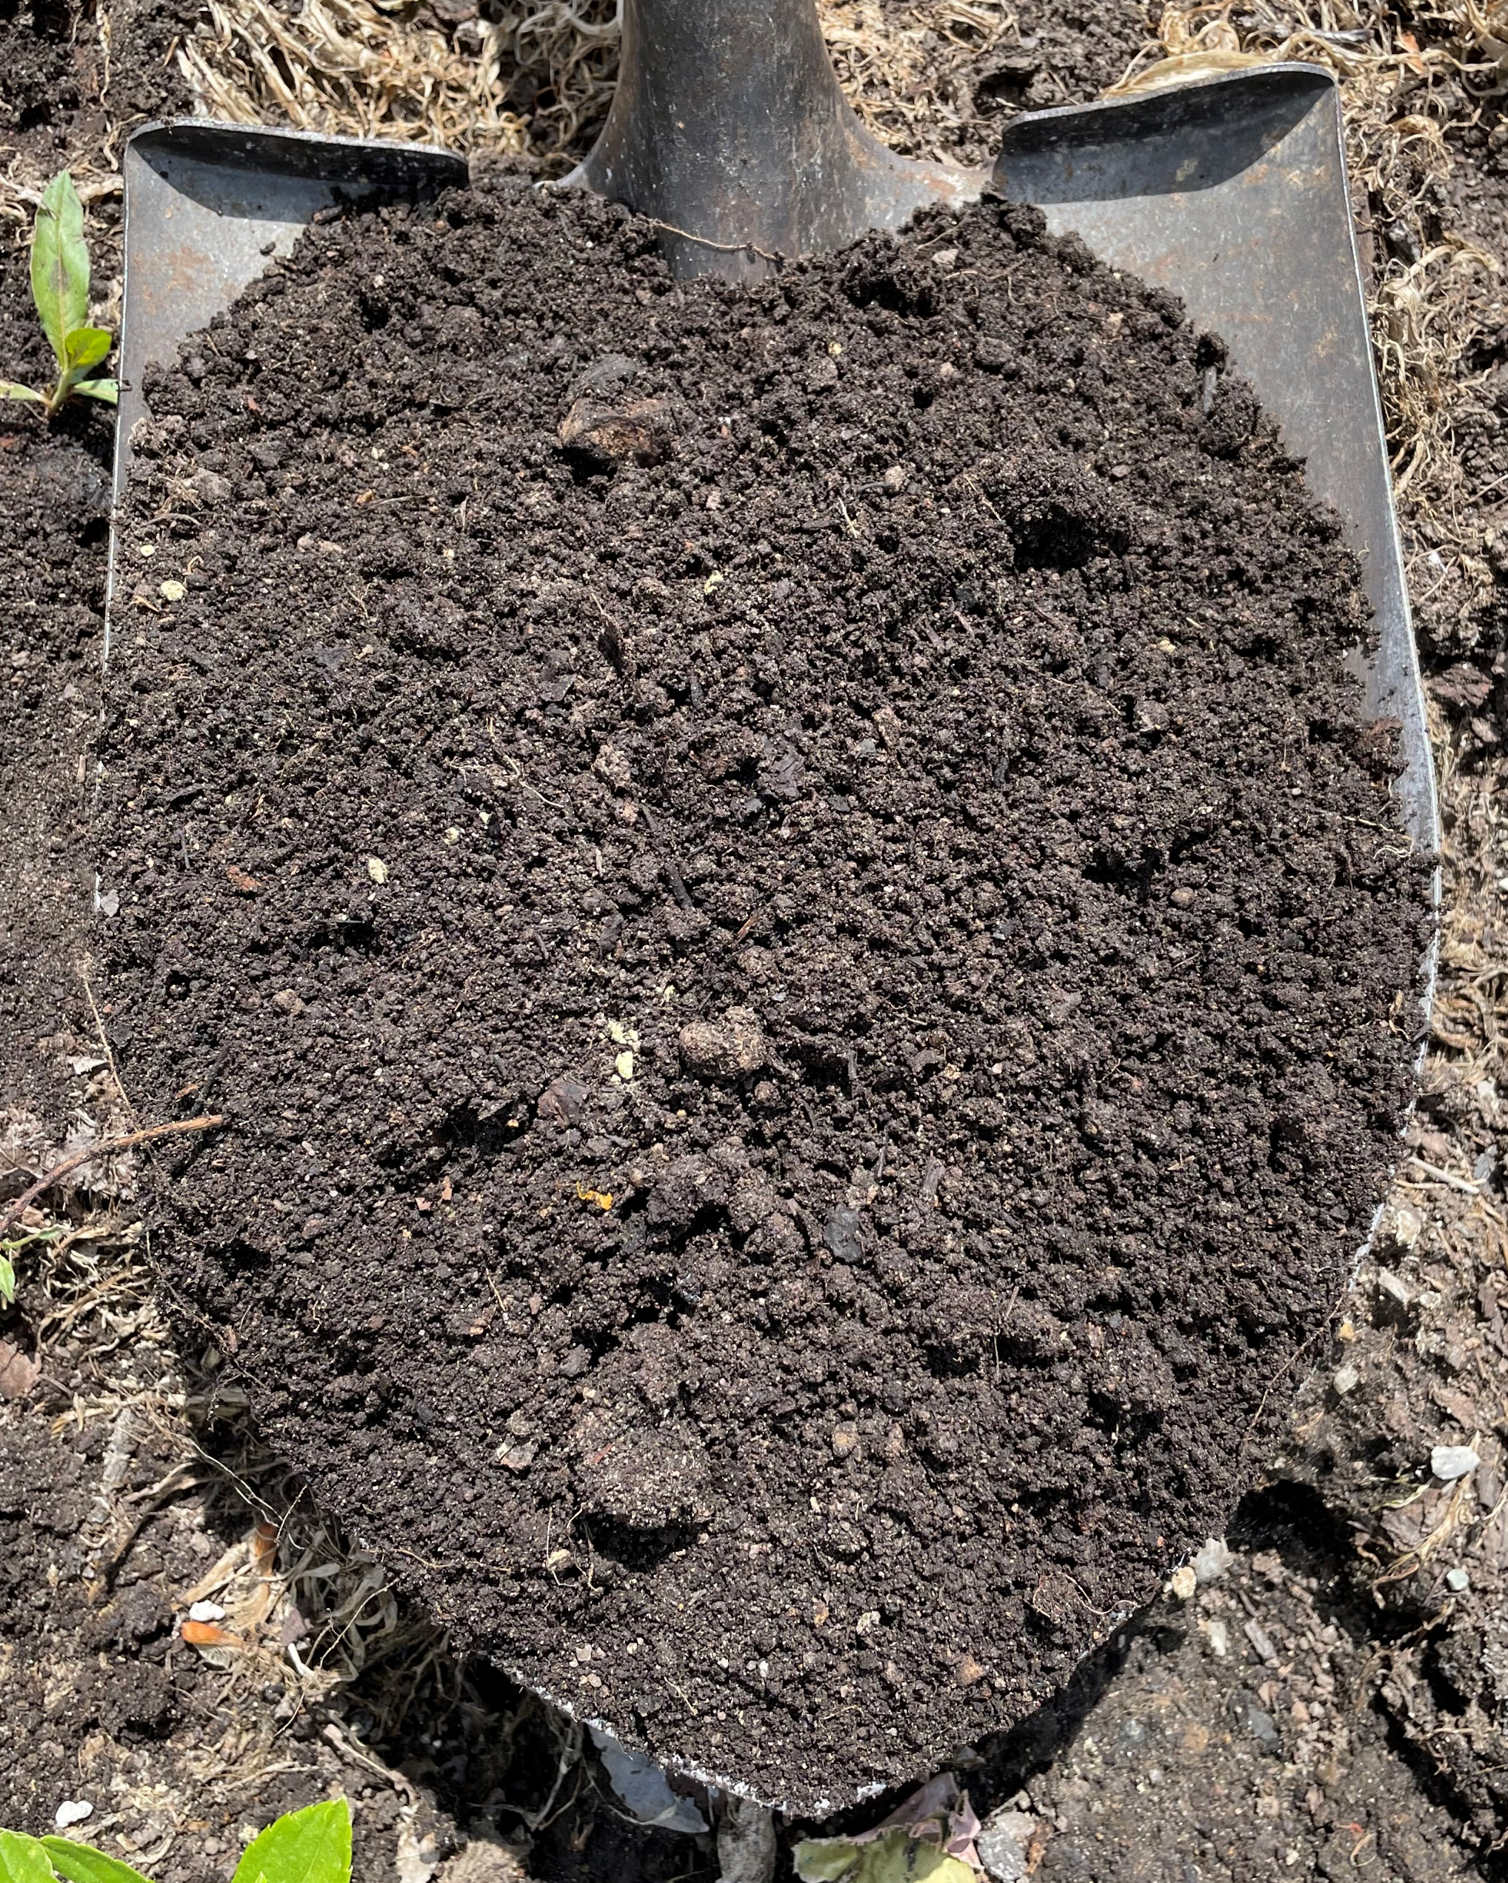
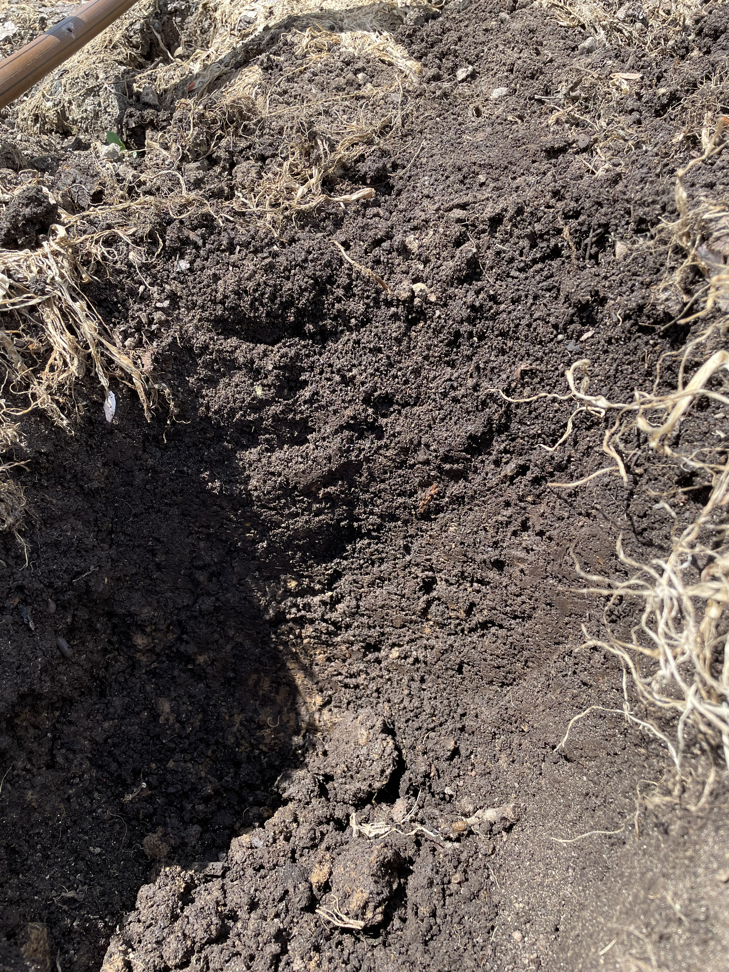
Resource Concerns ?
Notes:
The soil conditions at this site challenged many of the NRCS staff’s ideas about soil health. The soil did not perform well on some of the indicators from the Cropland IFSHA – particularly aggregate stability. Highly amended soils like this are currently a significant challenge to our NRCS assessment methods. Another concern was that perhaps the nutrient content of the soil was enough to generate risk of nutrient loading in runoff.
The soil was, however, very soft to the touch with loose aerated structure to a significant depth in the profile. There did not appear to be any root restrictions and crops were growing well at the site.
Photos: Josh Beniston, USDA NRCS (L) Hole/small profile dug in garden bed at the site, (R) Loose, fine, granular structure of the soil surface at the site.

Slide 39
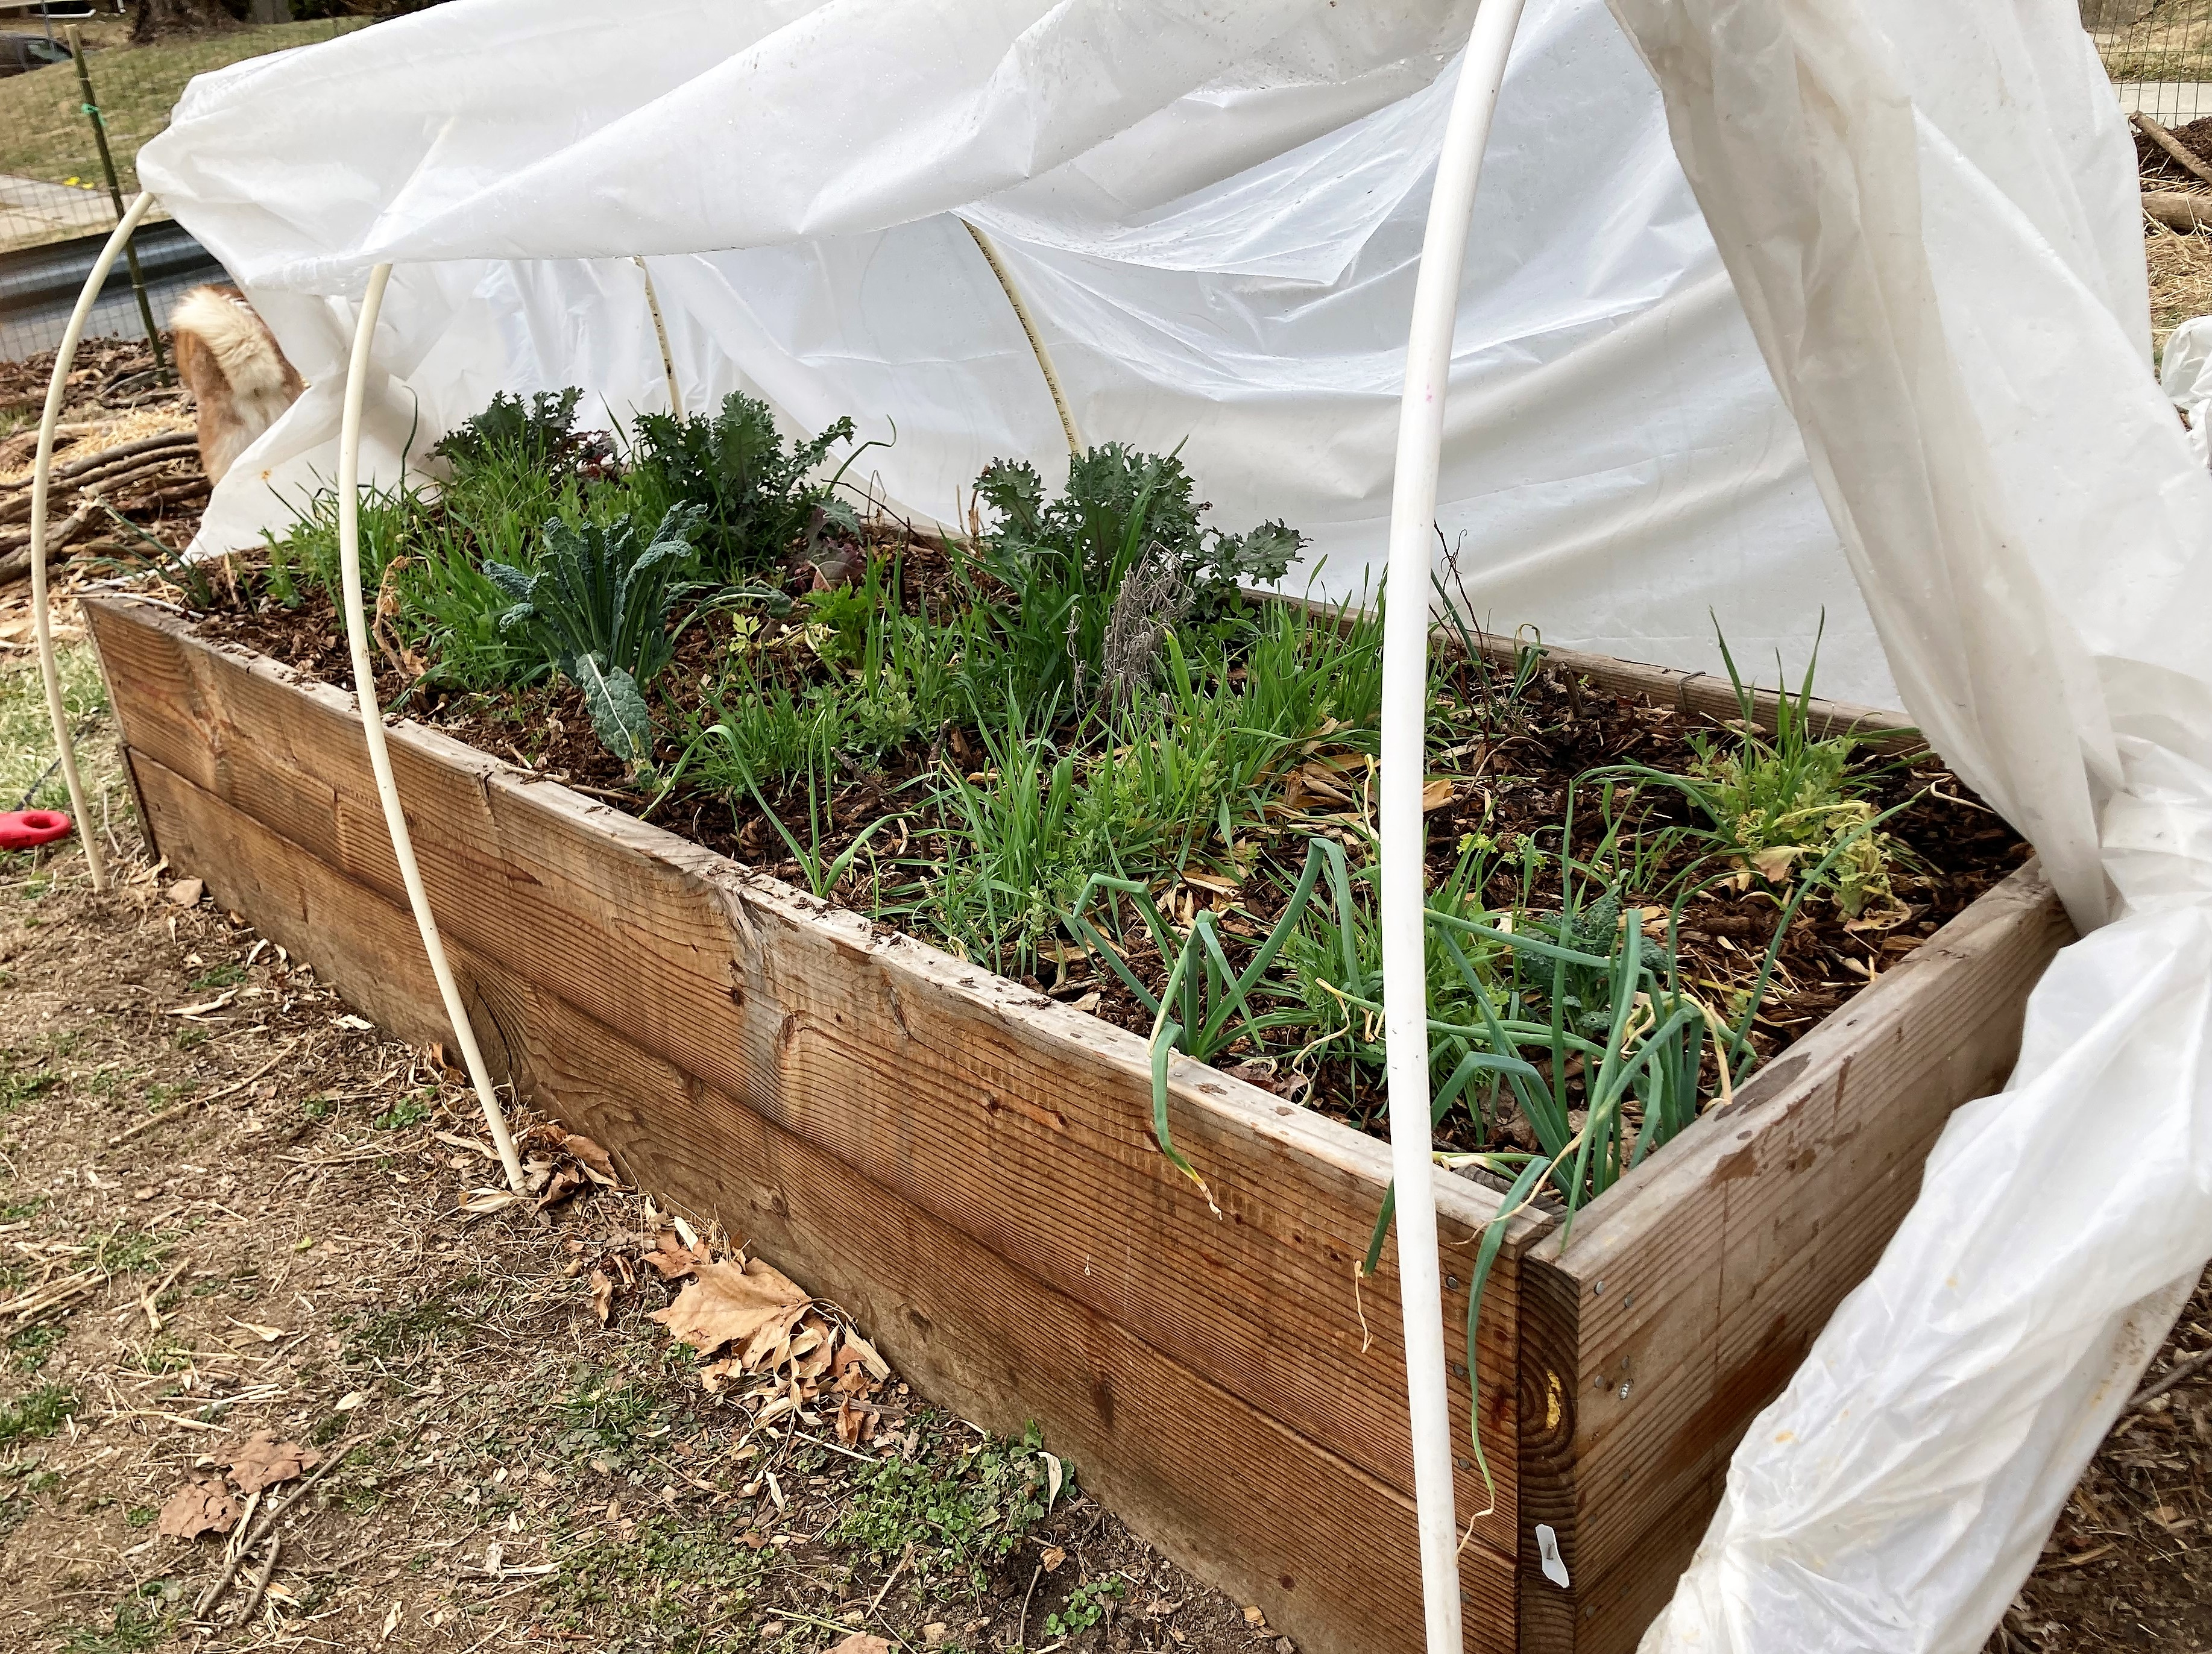
Notes:
Along similar lines as the previous slide, this is a constructed raised bed in a community garden in Baltimore MD. The bed has been filled entirely with compost. Constructed raised beds filled with soilless media provide interesting and sometimes challenging questions for NRCS planners. How can we assess resource concerns accurately in this material? How do we advise producers to manage these systems for long term ecological health? Does soilless media in a raised bed have soil health?
There are some answers to these questions. We know that soil nutrient testing can be beneficial for these systems. We also assume that managing these sites according to the soil health principles and incorporating well known conservation practices such as cover cropping are likely beneficial.
Overall, highly amended urban soils and urban gardens with soilless media are an area where we are actively working to review the available information and come up with guidance to support producers with soil health management.
Photo: Valerie Cohen, USDA NRCS.

Slide 40
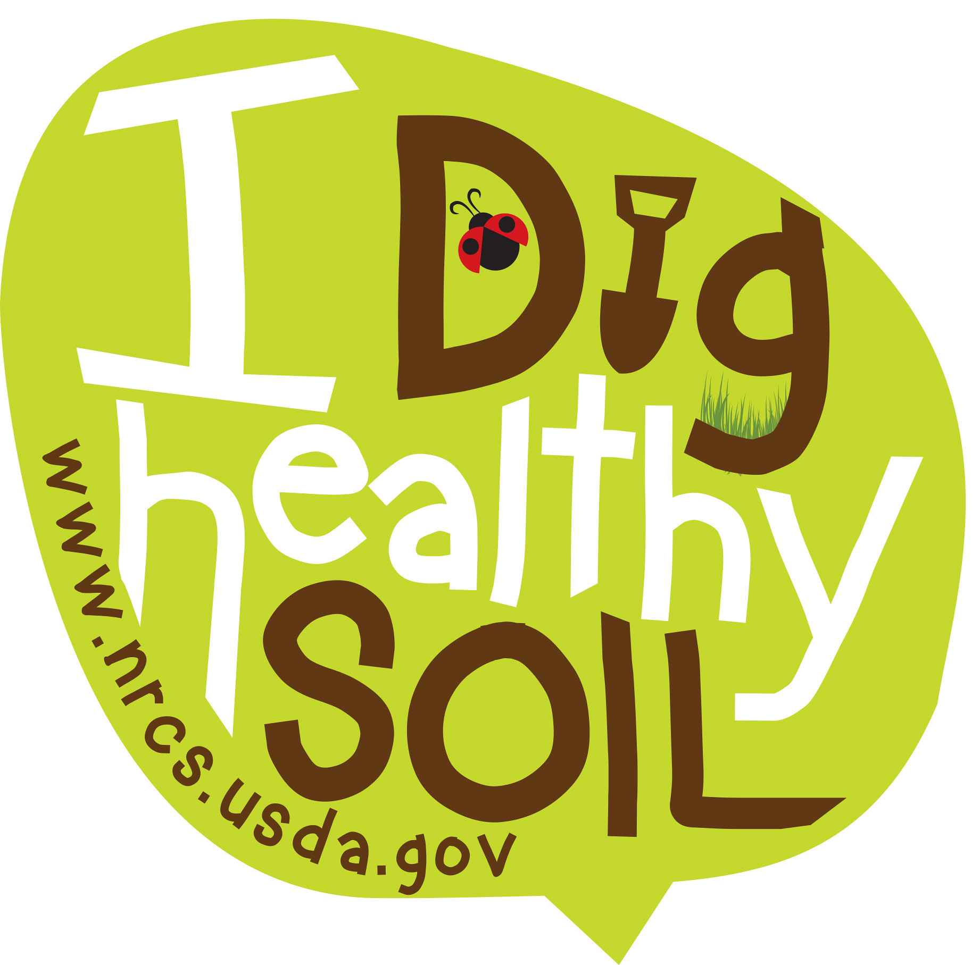
Questions and Review

Slide 41

This information is provided as a public service and constitutes no endorsement by the United States Department of Agriculture or the Natural Resources Conservation Service of any service, supply, or equipment listed.
While an effort has been made to provide a complete and accurate listing of services, supplies, and equipment, omissions or other errors may occur and, therefore, other available sources of information should be consulted
The USDA is an equal opportunity provider and employer.
Meeh, NRCS

